Slide 1
Renal Clearance in the ICU
Notes:
Delirium is a form of acute brain dysfunction encountered in critically ill adults and a significant cause of morbidity and mortality.

Slide 2
Determinants of Glomerular Filtration Rate
Net Filtration Pressure
10 mm Hg
Glomerular Hydrostatic Pressure
60 mm Hg
Bowman’s Capsule Pressure
18 mm Hg
Glomerular Oncotic Pressure
32 mm Hg
=
-
-

Slide 3
Blood Flow Autoregulation

Slide 4
What is Renal Clearance?
Clearance of X: ml/min
The volume of plasma that is completely cleared of a substance by the kidney per unit time

Slide 5
Input = Output
Assuming the kidney neither produce or metabolize substance X

Slide 6
Renal Clearance of X
1 mg of X per mL of plasma
Clearance of X: 10 mL/min
10 mg of X excreted per minute
Every one minute, there will be 10 mL of plasma completely devoid of substance X

Slide 7
Renal Clearance of X
Reduced concentration of X

Slide 8
Renal Clearance Formula
$Px X Cx=Ux X \dot{V}$
$Cx= \frac{Ux X \dot{V}}{Px}$
$Ux$: Urinary concentration of X (mg/mL)
$V$: Urinary volume (mL/min)
$Px$: Plasma concentration of X (mg/mL)
$Cx$: Clearance rate of X (mL/min)

Slide 9
Renal Clearance Formula
$Cx= \frac{Ux X \dot{V}}{Px}$
$$Cx= \frac{10 mg/mL X \dot{1 mL}}{1 mg/mL}$$
$Ux$: Urinary concentration of X (mg/mL)
$V$: Urinary volume (mL/min)
$Px$: Plasma concentration of X (mg/mL)
$Cx$: Clearance rate of X (mL/min)

Slide 10
Renal Clearance Rate

Slide 11
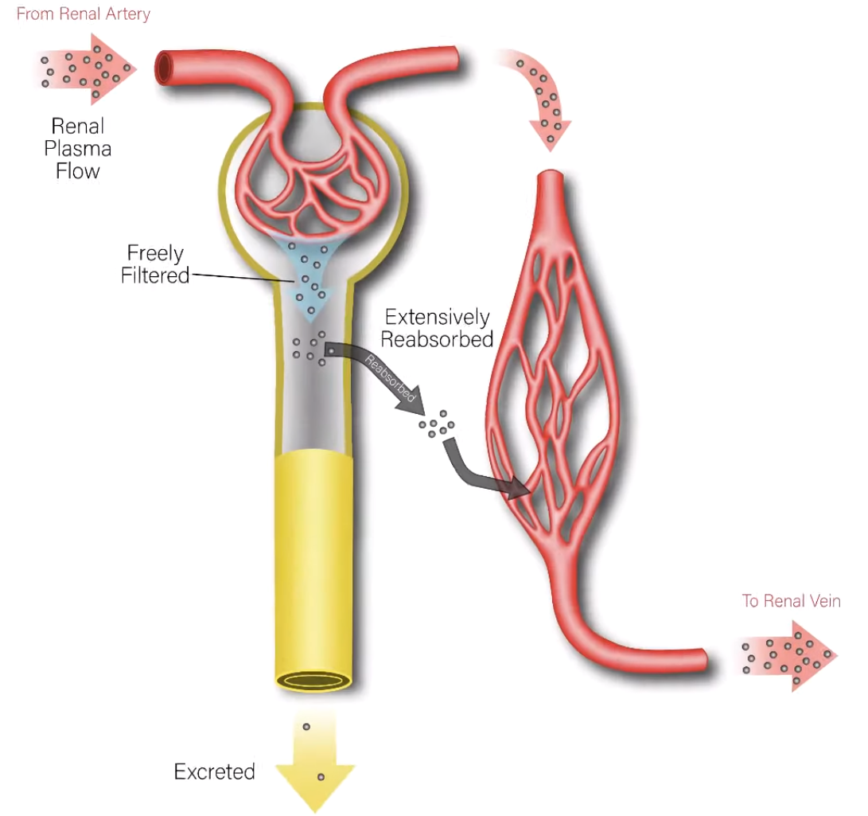
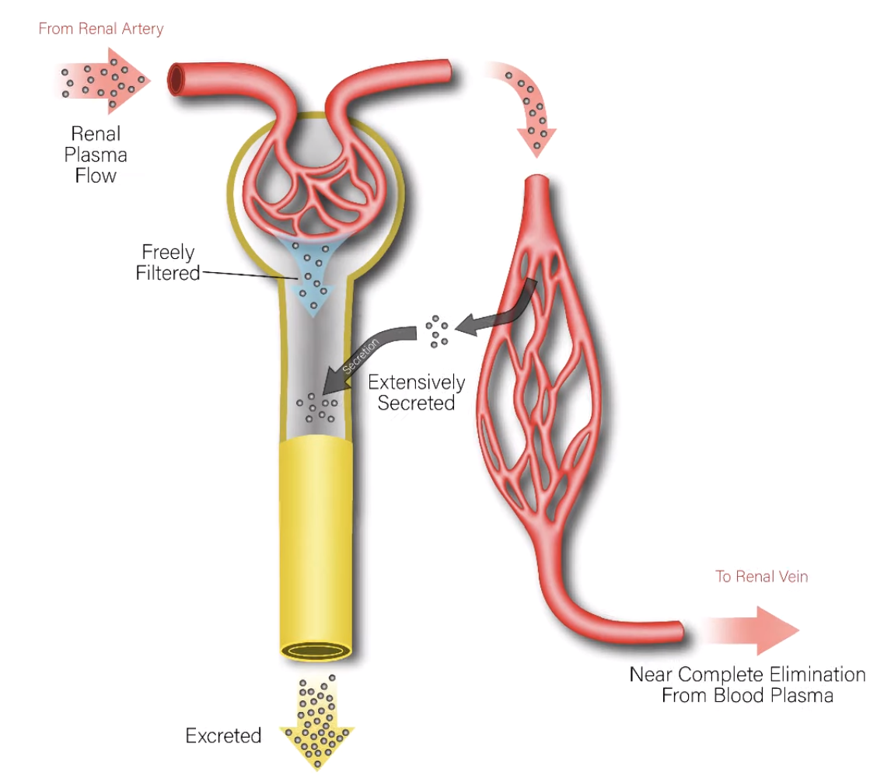
What Determines Renal Clearance Rates?
Moderate Clearance Rate
Creatinine
Low Clearance Rate
Glucose/Inulin
High Clearance Rate
Para-aminohippuric Acid

Slide 12
Glomerular Filtration Rate

Slide 13
Factors Affecting Estimating GFR in ICU setting
Fluctuations of serum creatinine over time:
Fluid balance variations:
Fluctuating renal hemodynamics:
Non-steady state
Under or over estimation of creatinine level
Augmented renal clearance
Change in oncotic pressure due to low albumin
Increased filtration rate
Commonly used creatinine-based equations are flawed in the critical care setting. Ideal methods like inulin clearance become impractical in an ICU setup
24-h urine collection is not practical
Both overdosing and underdosing are problems when GFR could not be estimated close to accuracy

Slide 14
Estimation of CrCl
Steady State Chronic Renal Failure
Cockcroft-Gault Formula
The 4-variable MDRD
The 6-variable MDRD
(140 − Age in years) × Body weight in kg/72 × Serum creatinine in mg/dl x 0.85 if female
170 x (serum creatinine)^{-0.999} x (age)^{-0.176} x (BUN)^{-0.170} x (Alb) + 0.318
186 x (serum creatinine)^{-1.154} x (age)^{-0.203} x 0.742 if female
Inaccurate estimation of GFR in a non-steady state (AKI and critically ill patients)

Slide 15
Jelliffe’s Equation
Relatively accurate estimation of GFR in a non-steady state as in AKI requires timed urine collections, which is not always practically possible in a critically ill patient, To overcome this, Jelliffe introduced an equation in 2002:
Estimated GFR = {(Volume of distribution × (Serum creatinine on day 1 − Serum creatinine on day 2)) + Creatinine production} 100/1,440/Average serum creatinine
Creatinine is a hydrosoluble substance and its concentration
changes with fluctuations in total body water
? Fluid balance variation
Creatinine production
Dynamic changes in creatinine
[29.305 − (0.203 × age)] × weight × [1.037 − (0.0338 × average
Cr)] × correction for gender (0.85 for males and 0.765 for females).
Volume of distribution: 0.4× weight (kg) × 10.
Body weight is defined as initial hospital admission weight.
When sCr rises, sCr on Day 2 is used instead of average sCr.

Slide 16
Modified Jelliffe’s Equation
Relatively accurate estimation of GFR in a non-steady state as in AKI requires timed urine collections, which is not always practically possible in a critically ill patient, To overcome this, Jelliffe introduced an equation in 2002:
Estimated GFR = {(Volume of distribution × (Adjusted serum creatinine on day 1 − Adjusted serum creatinine on day 2)) + Creatinine production} 100/1,440/Average serum creatinine
Creatinine production mg/day
Dynamic changes in creatinine
Adjusted Creatinine for Fluid Balance
[29.305 − (0.203 × age)] × weight in kg × [1.037 − (0.0338 × average Cr)] × correction for gender (0.85 for males and 0.765 for females).
Adjusted creatinine=sCr × correction factor
Correction factor=[hospital admission weight (kg)
×0.6 + ∑ (daily fluid balance)]/hospital admission weight × 0.6.
Volume of distribution: 0.6× weight (kg) × 10.
Body weight is defined as initial hospital admission weight.
When sCr rises, sCr on Day 2 is used instead of average sCr.

Slide 17
Chronic kidney disease-epidemiology (CKD-EPI) equation in critically ill patients
CKD-EPI GFR = 141 x min(serum creatinine/k,1)^{α} x max(serum creatinine/k,1)^{-1.209} x 0.993^{age} x 1.018(if female) x (1.159 if black)
Where k is 0.7 for females and 0.9 for male patients
a is −0.329 for female patients and −0.411 for male patients
min indicates the minimum of creatinine/k or 1
max indicates the maximum of creatinine/k or 1)
Needs to be further validated in clinical settings

Slide 18
Cystatin C
Cystatin C is a non-glycosylated protein produced by all nucleated cells at a constant rate.
Its constant rate of production, low molecular weight of 13 kDa, and positive charge at physiological pH makes it a suitable marker for glomerular filtration.
It is reabsorbed and almost completely catabolized in the proximal tubule.
It is found in relatively high concentrations in many body fluids, especially in the seminal fluid, cerebrospinal fluid, and synovial fluid
It has extreme sensitivity to small changes in GFR and higher diagnostic accuracy than creatinine in estimating GFR
Its concentration is least affected by infections, malignancies, steroid therapy, inflammatory disorders, and muscle mass (no adjustment with age or gender)

Slide 19
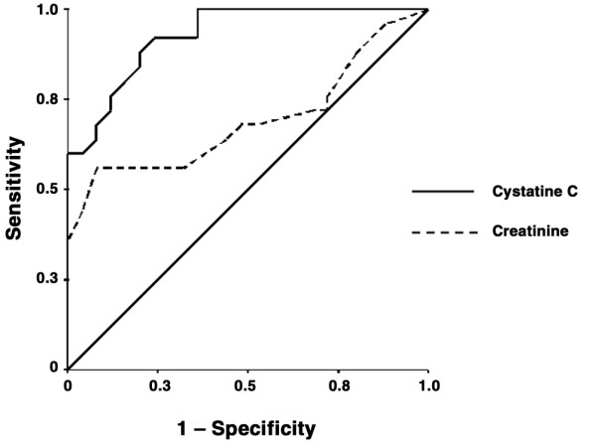
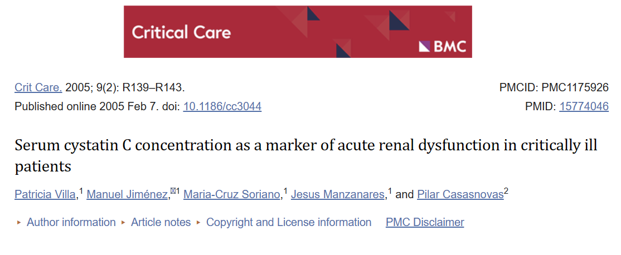
Estimating GFR from Cystatin C
Grubb's equation: GFR = 83.93 × Cystatin C^{−1.676}
Area under the curve for cystatin C 0.927 and for creatinine 0.694

Slide 20
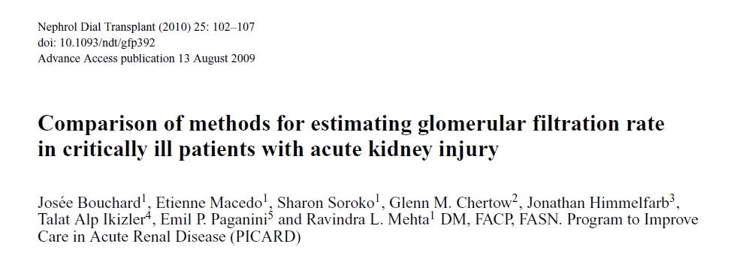
Bouchard J, et al. Nephrol Dial Transplant. 2010 Jan;25(1):102-7.

Slide 21
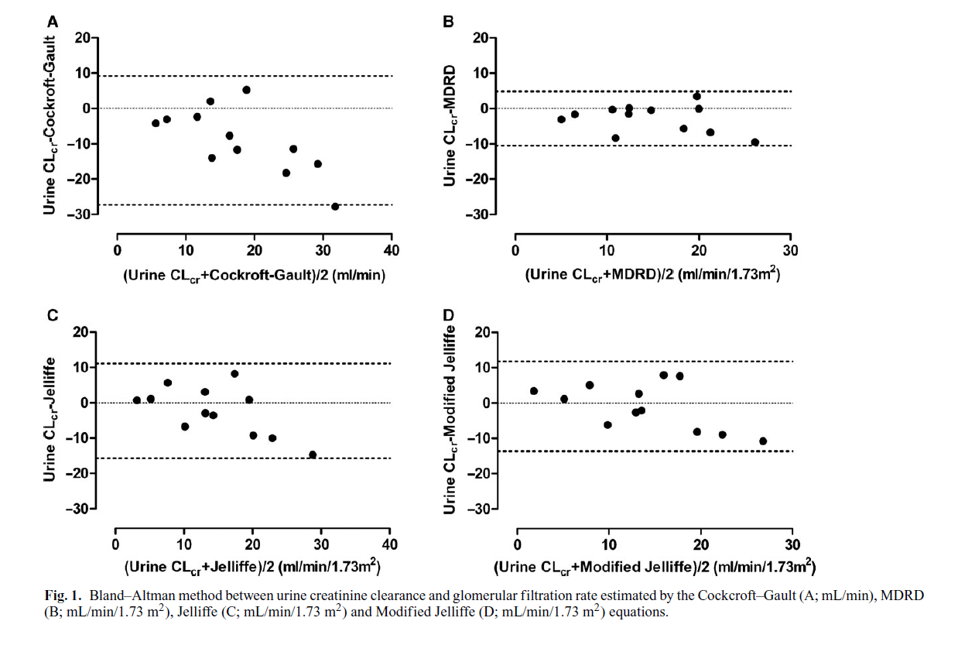
Overestimated urinary creatinine clearance by 80%
Overestimated urinary creatinine clearance by 10%
Overestimated urinary creatinine clearance by 33%
Underestimated urinary creatinine clearance by 2%
Bouchard J, et al. Nephrol Dial Transplant. 2010 Jan;25(1):102-7.

Slide 22
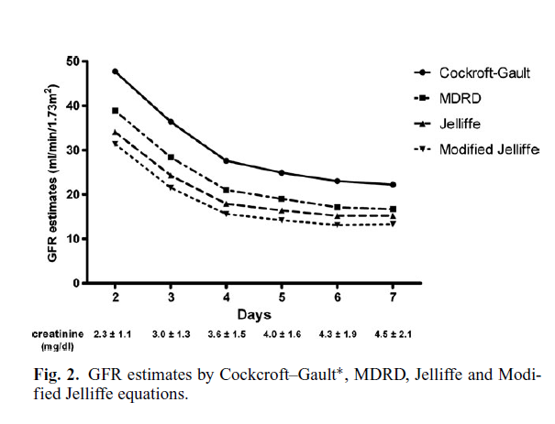
The relative overestimation in Cockcroft–Gault GFR compared to Modified Jelliffe GFR estimates was higher at AKI diagnosis (16.3 mL/min) and decreased as kidney function declined over time (8.9 mL/min).
Bouchard J, et al. Nephrol Dial Transplant. 2010 Jan;25(1):102-7.

Slide 23
Augmented Renal Clearance
ARC is defined as estimated GFR > 130 ml/min
Demonstrated in patients with traumatic brain injury, burns, sepsis, surgery, and in ICU patients
Younger patients
Lower Acute Physiology And Chronic Health Evaluation (APACHE) II scores
Higher diastolic blood pressures
Higher urine output on the first morning of admission to the ICU
Cytokine release from acute injury, the innate immune and inflammatory responses to trauma, and aggressive fluid resuscitation may promote increased organ blood flow and enhanced excretory function.

Slide 24
Determinants of Glomerular Filtration Rate
Net Filtration Pressure
↑ Glomerular Hydrostatic Pressure
Epinephrine
Fluid resuscitation
Bowman’s Capsule Pressure
↓ Glomerular Oncotic Pressure
Low albumin
=
-
-

Slide 25
In Summary
The issue of ARC should be considered to avoid improper dosing of drugs.
Cockcroft-Gault and 4-variable MDRD equations should better be avoided in ICU setup.
These methods could be employed in this order to estimate renal function and to provide instant and accurate results.
Cystatin C
Modified Jelliffe’s
Jelliffe’s
6-variable MDRD equations

