Slide 1
Early Mobility in the ICU
Notes:
Early mobilization and rehabilitation of patients in intensive care units may improve physical function, and reduce the duration of delirium, mechanical ventilation, and ICU length of stay.

Slide 2
Progressive Mobility in the ICU
What are the risks of bedrest!
Is it safe?
What are the outcomes?
How do we do it?
Notes:
In this presentation, we will examine the risks of immobility, explore the literature to determine the safety and outcomes of mobility in the ICU, then will present a progressive mobility program that you can implement in your ICU.

Slide 3
Immobility has its Risks
Loss of lean muscle tissue:
18% throughout average ICU stay
1.5% to 2% per day⁸
Increased insulin resistance
Thromboembolic disease
Microvascular dysfunction
Systemic Inflammation
Atelectasis
Pressure Ulcers
Joint contractures
Winkelman, C. Inactivity and Inflammation in the Critically Ill Patient. Critical Care Clinics 2007:23:21-34 Brower, Roy G. MD.
Consequences of bed rest. Critical Care Medicine 37(10):p S422-S428, October 2009.
Notes:
Prolonged immobility in ICU patients has its own implications, patients can lose between 1.5 to 2% of their lean muscle mass daily with bed rest, which can accumulate to an 18% loss throughout their ICU stay. Insulin resistance can develop within the first five days of immobility in patients without a pre-existing diabetes diagnosis. Moreover, continuous bed rest can lead to a reduction in blood circulation, increasing the risk of thromboembolic diseases.
Further complications associated with extended bed rest include diminished arterial diameter, leading to decreased arterial flow, increase systolic blood pressure and increased systemic vascular resistance which may contribute to multi-organ dysfunction, skin ulcers, intestinal ischemia. In addition, bedrest prohibits the beneficial effects of exercise in reducing systemic inflammation. Atelectasis may also complicate immobility. Finally, a significant percentage of ICU patients—approximately one-third—may develop joint contractures, especially in the elbows and ankles, due to the lack of movement.

Slide 4
Mobility in ICU is Safe
Potential safety events
583 (2.6%)
Fall (11, 0.07%)
Endotracheal tube removal (2, 0.01%)
Intravascular catheter event (35, 0.2%)
Other catheter or tube removal (15, 0.9%)
Cardiac arrest (4, 0.03%)
Hemodynamic changes (126, 0.7%)
Desaturation (78, 0.5%)
Events with consequence, including stop rehab
78 (0.6%)
1 fall
11 tube removal
34 hemodynamic changes
18 desaturation,
14 other
Included Adult studies of ICU mobility with safety data: 48 publications (n=7,546 pts; 22,351 sessions)
6 RCT, 2 Non-randomized trial, 5 before-after, 22 prospective cohort, 11 retro cohort, 2 prevalence studies
Notes:
So we want to make sure that mobilizing in critical care is safe. In this systematic review in which there were 48 eligible publications evaluating 7,546 patients, with 583 potential safety events occurring in 22,351 mobilization and rehabilitation sessions at a rate of 2.6%. The most frequently reported types of event were oxygen desaturation and hemodynamic changes, followed by removal or dysfunction of intravascular catheter. However, there were only 78 events out of all mobilizing opportunities with consequences at a rate of 0.6%. Of note, stopping rehab was included as an event of consequence.

Slide 5
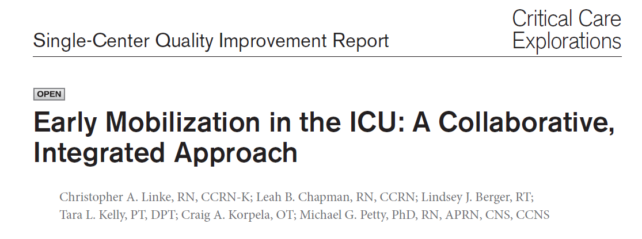
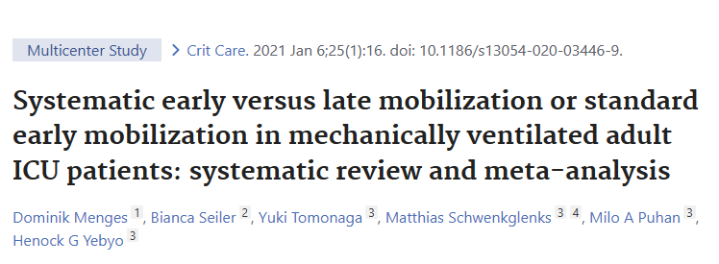
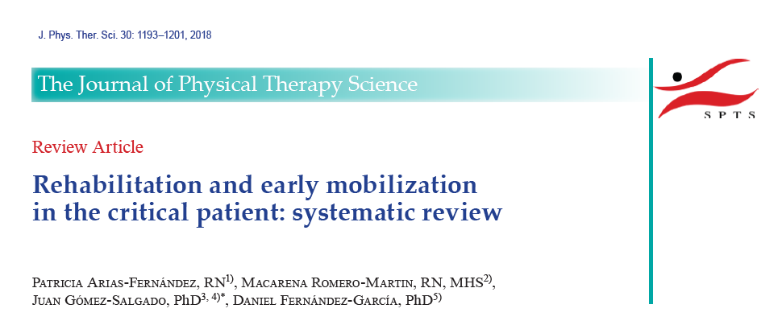
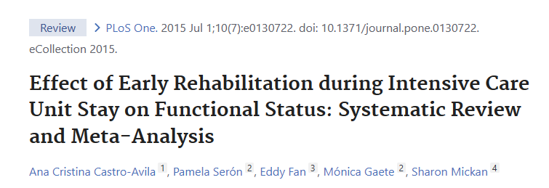
Notes:
Although not conclusive, but multiple studies have shown that initiating early mobilization after ICU admission reduces the incidence of ICU-acquired weakness and delirium, length of ICU and hospital stays, duration of mechanical ventilation, and medical costs while improving quality of life.

Slide 6
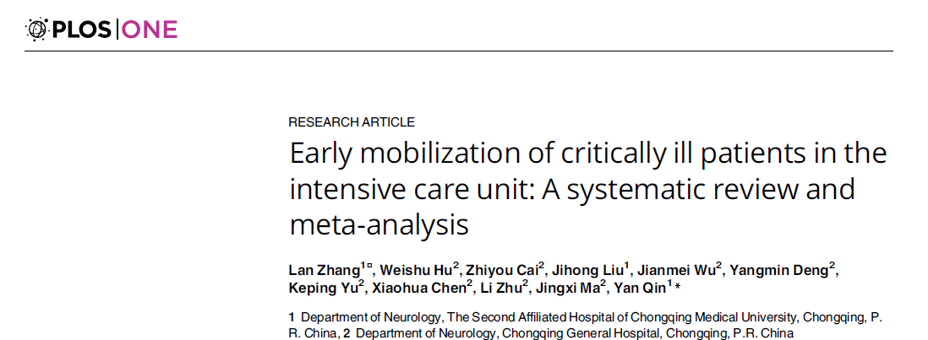
Notes:
In a meta-analysis published in 2019, early mobilization decreased the incidence of ICU-AW, improved the functional capacity, and increased the number of ventilator-free days and the discharged-to-home rate for patients with a critical illness in the ICU setting.

Slide 7
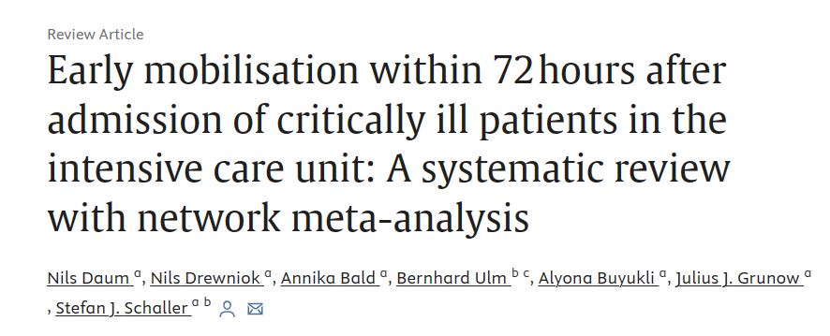
Notes:
Another recent meta-analysis that is set to be published in February 2024 in the intensive and critical care nursing journal showed that early mobilization alone and early mobilization with early nutrition demonstrated a significant effect on intensive care length of stay. Early mobilization could also reduce hospital length of stay and positively influence functionality and quality of life.

Slide 8
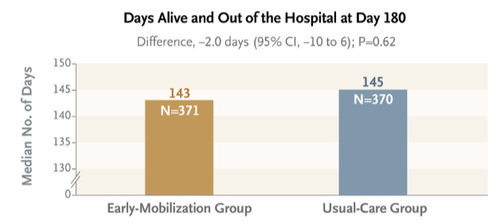
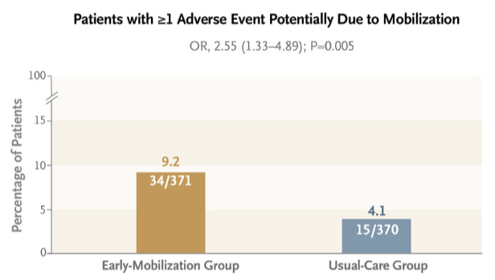
Notes:
It is also worth noting that the TEAM trial published in New England Journal of Medicine revealed that days alive and out of the hospital at day 180 were not different between the two groups, and in fact the intervention group had increased incidence of adverse events compared to the usual care group. However, the intervention group utilized a more aggressive hierarchical protocol where the objective of each mobility session began with the highest level of activity possible for the longest time possible, which then steps down to lower levels of activity if the patient fatigues. The usual care group in the study used a build up approach of progressive mobility similar the recommendations of the PADIS guidelines.

Slide 9
Progressive Mobility Program
Standards on all patients
HOB 30 degrees
Active and passive range of motion
Minimize back time if able
Observe weight bearing
Turn every 2 hours
Mobilization
Progressive
Early
No exclusion criteria
Notes:
So we know it is safe to mobilize. We know we should mobilize because bedrest is bad. And we have a guidelines to outline a general idea. Now let’s get into the details of the progressive mobility program in the IUC. Of course, all patients should have the standards of care that include turning every 2 hours, keeping the head of bed at 30 degrees, doing active and passive range of motion, minimizing back time if able, and observing weight bearing. If the patient does not have any of the exclusion criteria that will be discussed in the next slide, then you can proceed with the early and progressive mobility as tolerated.

Slide 10
Exclusion Criteria
Hemodynamics
New or increase of any vasopressors in the last 2 hours
Cardiovascular
Support devices: IABP, Impella, others
DVT/VTE
Pulmonary
FiO2 >60%
PEEP >15 cm H2O
Unsecured or critical airway
Neuro
Actively treating unstable ICP
Acute or uncontrolled intracranial event
Receiving paralytic agent
Notes:
The exclusion criteria involves new or increase of any vasopressors in the last 2 hours, the presence of cardiac support devices such as intra-aortic balloon pump or Impella, the presence of DVT or PE (but upon the discretion of the treating physician), high requirement of respiratory support with FiO2 >60%, PEEP >15 cm H2O, or the presence of unsecured or critical airway. Neurological conditions that exclude patients from early mobility may include elevated ICP, acute or uncontrolled intracranial event, or if the patient is receiving paralytic agent.

Slide 11
Mobility in the ICU
Notes:
Once the patient is deemed appropriate for mobility, it should be started as soon as possible and advance through the different levels as tolerated. Start with dangling and passive transfer, then transition to standing and active transfer to the chair before walking with assistance and finally walking independently. The specifics of each level is provided in the shown infographic.

Slide 12
Every moment matters
Every Moment Matters
Delirium prevention
Progressive mobility
Sleep promotion
Notes:
Finally, in progressing within your institution towards a safer and higher quality care, every moment matters during the presence of the critically ill patient in the ICU as it may be an opportunity to prevent delirium and advance the progress of care. Thanks you.

