Slide 1
Sedative Agents

Slide 2
Sedatives Pharmacology
Benzodiazepines
Propofol
Dexmedetomidine
Ketamine
Notes:
In this presentation, I will present the pharmacology of the main sedatives used in the intensive care unit including benzodiazepine, propofol, dexmedetomidine, and ketamine.

Slide 3
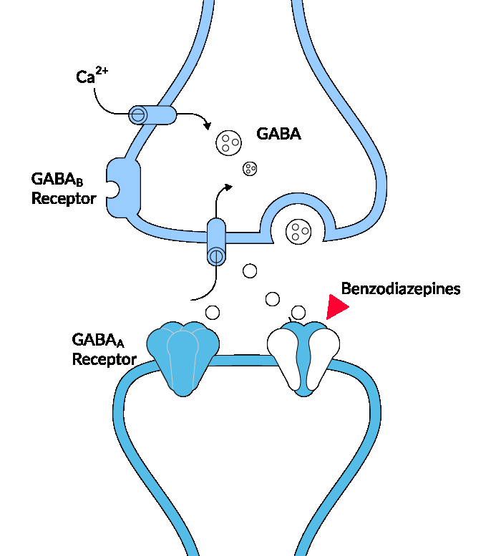
Benzodiazepines Mechanism of Action
Griffin CE 3rd, et al. Ochsner J. 2013 Summer;13(2):214-23.
Notes:
Gamma-aminobutyric acid (GABA) is the most common neurotransmitter in the central nervous system, found in high concentrations in the cortex and limbic system and has an inhibitory effect on GABA receptors. The GABA_{A} chloride ion channel is a protein complex pentameric form that has varying combinations of α, β, and γ subunits. GABA binds to a site near the junction of α and β subunits, and this causes conformational changes that open the chloride ion channel and lead to neuronal membrane hyperpolarization. Benzodiazepines are a GABA –A receptor agonist that bind to an allosteric site formed by the cleft between α and γ subunits, and this facilitates GABA binding and increases the frequency of chloride channel opening.

Slide 4
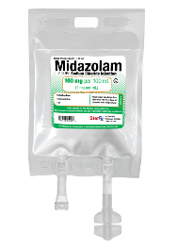
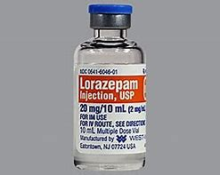
Benzodiazepines Pharmacology
Drug | MOA | Onset | Duration | Dose | Metabolism | Adverse Effect
Midazolam | GABA receptor agonist | 3-5 min | 2-6 hr. | 0.02-0.1 mg/kg/hr. | Hepatically 3A4 substrate | Oversedation Amnesia Respiratory depression
Lorazepam | GABA receptor agonist | 5-20 min | 4-8 hr. | 0.01-0.1 mg/kg/h 1-4 mg IV q 4-6 hr. | Direct glucuronidation | Oversedation Propylene glycol toxicity Respiratory depression
Griffin CE 3rd, et al. Ochsner J. 2013 Summer;13(2):214-23.
Notes:
Benzodiazepines agents vary in their lipophilicity, active metabolites, onset, and elimination half life.
Midazolam is more lipid soluble than lorazepam resulting in a quick onset of sedation and a larger volume of distribution. Its lipophilicity allows for rapid penetration through blood brain barriers, these characteristics make midazolam a good choice for continues infusion administration. The sedative effect of midazolam is associated with anxiolysis and amnesia. Midazolam metabolizes in the liver via the cytochrome p450 system which leads to potential drug-drug interactions with medications that either inhibit or induce cytochrome p450. It is associated with active metabolites that have prolong sedative effects and can accumulate in renal failure.
Lorazepam as a longer time to onset and duration of action as it is not as lipophilic as midazolam which makes it a good choice in the initial treatment of status epilepticus. Lorazepam exhibit direct glucuronidation thus it can be used safely in patients with renal and hepatic dysfunction with minor side effects. Lorazepam is used as intermitted doses and should be avoided as a continuous infusion as higher doses are associated with propylene glycol related toxicity.
The half-life of these agents makes it difficult to achieve light sedation and perform daily sedation vacation trials paired with spontaneous breathing trials. Benzodiazepines should be reserved for patients who require a deep level of sedation such as in cases of status epilepticus, alcohol withdrawal, the use of neuromuscular blockade, and in those patients with benzodiazepine dependence or withdrawal, or when patients are intolerant to other agents. Of note, these agents are associated with a higher rate of delirium in critically ill patients.

Slide 5
Risk of Delirium Associated with Benzodiazepines
Pandharipande P, Shintani A, Peterson J, Pun BT, Wilkinson GR, Dittus RS, Bernard GR, Ely EW. Lorazepam is an independent risk factor for transitioning to delirium in intensive care unit patients. Anesthesiology. 2006 Jan;104(1):21-6.
Notes:
Benzodiazepine use may be associated with an increased risk of developing delirium, In a study published in 2006, the probability of transitioning to delirium increased with the dose of lorazepam administered in the previous 24 hours. This incremental risk was large at low doses and reached 100% at around 20 mg per day.

Slide 6
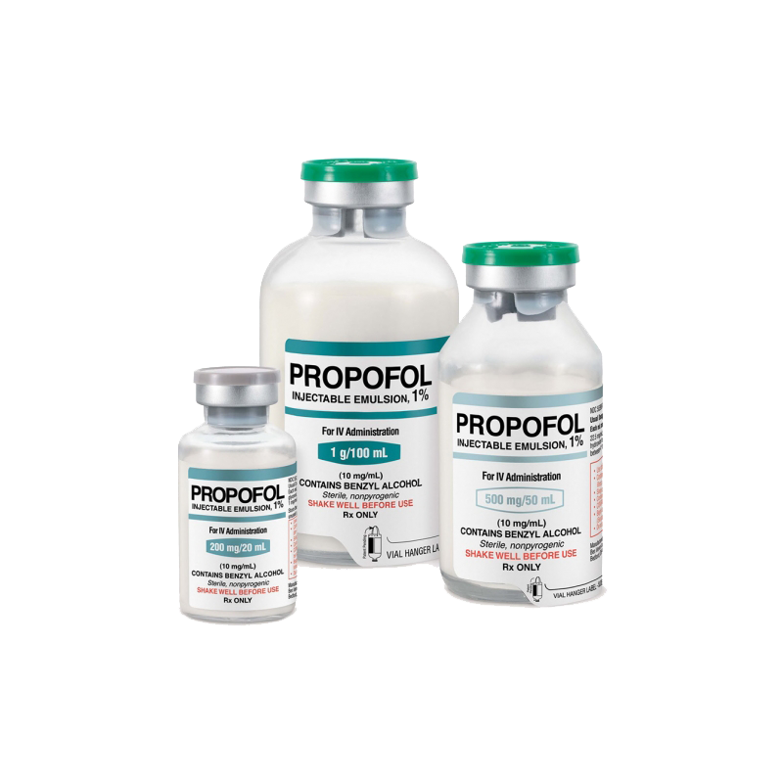
Propofol Mechanism of Action
Antkowiak B, Rammes G. GABA(A) receptor-targeted drug development -New perspectives in perioperative anesthesia. Expert Opin Drug Discov. 2019 Jul;14(7):683-699.
Notes:
Propofol is an anesthetic agent that prepared in lipid emulsion. Its formulation contains soybean oil, glycerol, egg lecithin, and a small amount of the preservative EDTA. Propofol binds to GABA-A, glycine, nicotinic, and M1 muscarinic receptors. Like most general anesthetic agents, the mechanism of action for propofol is poorly understood but thought to be related to the effects on GABA-mediated chloride channels in the brain. Propofol may work by decreasing the dissociation of GABA from GABA receptors in the brain and potentiating the inhibitory effects of the neurotransmitter. This, in turn, keeps the channel activated for a longer duration resulting in an increase in chloride conductance across the neuron, causing a hyper-polarization of the cell membrane, making it harder for a successful action potential to fire.

Slide 7
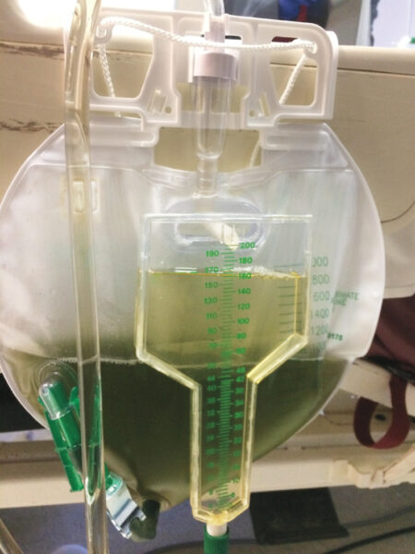
Propofol Pharmacology
Propofol
MOA | Binds to GABA_{A}, glycine, nicotinic, M1 muscarinic receptors
Onset | 1-2 min
Duration | 0.5-1 hr.
Dose | 0.3-3 mg/kg/hr. 5–50 mcg/kg/min
Metabolism | Hepatically
Adverse Effect | PRIS Bradycardia hypotension Green discoloration of urine
PRIS: Propofol-Related Infusion Syndrome
Folino TB, Muco E, Safadi AO, et al. Propofol. [Updated 2023 Jul 24]. In: StatPearls [Internet]. Treasure Island (FL): StatPearls Publishing; 2023 Jan-
J. Greenwood, RD, Clinical Dietitian Specialist, VCHA - VA. Reviewed by members of the ICU QI/QA Committee 11/7/08. Update 7/12/2009
Notes:
Propofol has a quick onset within 1-2 minutes and half life is biphasic and dependent on the duration of infusion. The initial half-life is 40 minutes and the terminal half-life is 4 to 7 hours. After a 10-day infusion, the terminal half-life may be up to 1 to 3 days. It can also accumulate in adipose tissue. It is used in doses of 0.3 to 3 mg per kg per hour, and it metabolizes through hepatic oxidation. Propofol is a versatile sedative that can achieve both light and deep levels of sedation and can also be used as an anticonvulsant.
Propofol is formulated in a lipid emulsion and propofol 1% is associated with 1.1kcal/mL. Triglycerides should be routinely monitored in patients to avoid risk of hypertriglyceridemia induced pancreatitis. A typical cutoff of 500-750mg/dL is used to transition away from propofol therapy.
Main side effects that need to be considered during propofol therapy are bradycardia and hypotension, in addition to a rare but fatal syndrome known as propofol related infusion syndrome or PRIS. Of note, propofol causes a green discoloration of urine.

Slide 8
Propofol Related Infusion Syndrome
Epidemiology
The incidence of PRIS was 2.9% in a recent study
Risk Factors
Doses > 50 mcg/kg/minute for 48 hours or more.
Characteristics
Hypertriglyceridemia
Mechanism
Alterations in the liver metabolism of the lipid emulsion→ accumulation of ketone bodies & lactate
Disruptions in the mitochondrial respiratory chain and inhibition of oxidative phosphorylation.
Acute liver failure
Hyperkalemia
Acute renal failure
Cardiac arrhythmias
Rhabdomyolysis
Myoglobinuria
Elevated creatine kinase conc.
PRIS-associated mortality rate of 36.8%
Metabolic acidosis
Management of PRIS is the discontinuation of propofol infusion and supportive treatment
Li WK, et al. J Crit Care. 2022 Oct;71:154098
Stolllings et al. ACCP, 2020
Notes:
Propofol Related Infusion Syndrome is a rare but yet known side effect of propofol that occurs when high doses used for long duration
It occurs due to alterations in mitochondrial metabolism and electron transport chain function, but the exact mechanism of PRIS is still unknown.
It is characterized with hypertriglyceridemia, metabolic acidosis, acute renal failure, cardiac arrhythmias, and rhabdomyolysis.
PRIS is a diagnosis of exclusion. Management of Propofol Related Infusion Syndrome is the discontinuation of propofol infusion and supportive treatment

Slide 9
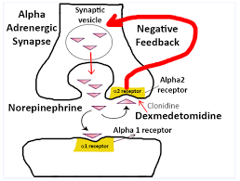
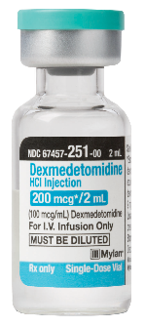
Dexmedetomidine
Dexmedetomidine | MOA
MOA | Selective alpha2 agonist
Onset | 5-10 min (with LD) 1-2 hr. (without LD)
Half life | 3 hours
Dose | LD: 0.5-1 mcg/kg 0.2-0.7 mcg/kg/hr. Trials used up to 1.5 mcg/kg/hr.
Adverse Effects | Bradycardia Hypotension Transit hypertension with LD
Reel B, Maani CV. Dexmedetomidine. 2023 May 1. In: StatPearls [Internet]. Treasure Island (FL): StatPearls Publishing; 2023 Jan
Notes:
Dexmedetomidine is a selective central alpha 2 agonist that exhibits sedative, anxiolytic, and analgesic effects. Presynaptic agonism of the receptor results in a negative feedback loop resulting in a reduction of catecholamine outflow. Dexmedetomidine does not suppress respiratory drive so it can be used in non-intubated patients. Of note, it is unable to deeply sedate patients so it should be avoided when deep sedation, and rass of -3 or less, is needed.
The peak effect of dexmedetomidine is 60 minutes if given over a continuous infusion. If an IV loading dose is used the onset is 5-10 minutes, however incidence of hypotension and bradycardia are increased so it should be reserved for agitated, hemodynamically stable patients who need rapid effect. Dexmedetomidine’s half life is approximately 3 hours, however, clearance and plasma protein binding are decreased in patients with hepatic impairment.
It has been FDA-approved for use in mechanically ventilated and non-intubated patients in ICU with doses 0.2-0.7 mcg per kg per hour however, doses up to 1.5 mcg per kg per hour have been used in the trials .
Hypotension and bradycardia are the most common side effects with dexmedetomidine use. Tolerance may develop with prolonged use, in addition to withdrawal if the infusion is used for greater than 72 hours.

Slide 10
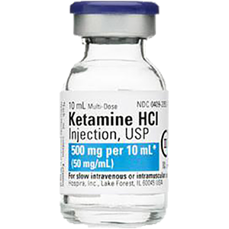
Ketamine
Ketamine | MOA
MOA | Noncompetitive NMDA receptor antagonist
Onset | 30 seconds
Half life | Alpha 10-15 minutes; Beta 2.5 hours
Dose | LD 1-2 mg/kg Maintenance infusion dose range is: 1-7.5 mg/kg/hr
Adverse Effects | Increased heart rate and blood pressure Emergence reactions Increased cerebral blood flow
Barr J, et al. Crit Care Med 2013; 41: 263-306.
Notes:
Ketamine is a noncompetitive NMDA receptor antagonist that blocks glutamine. It produces a cataleptic like state resulting in dissociation from the surrounding environment by direct action to the cortex and limbic system. It can be used as an anxiolytic, amnestic, sedative, analgesic, and anticonvulsant.
It has a rapid onset, offset in the beta phase is about 2.5 hours. Ketamine’s active metabolite, norketamine is primarily formed by CYP3A4 and is renally excreted so it can accumulate in renal failure.
For adverse effects, patients can have an increased heart rate and blood pressure however this side effect does not occur in catecholamine depleted patients. Resolution of blood pressure occurs within 15 minutes after peak effect.
Prolonged emergence from anesthesia, which can manifest as vivid dreams, hallucinations, and/or frank delirium commonly occur. Emergence reactions can occur up to 24 hours after administration. Risk factors include higher doses, females, excessive stimulation during recovery, history of personality disorder, and ketamine monotherapy. Of note, benzodiazepines can be used concurrently to minimize emergence reactions.
Ketamine can increase cerebral blood flow. This has been related to increased intracranial pressure with higher doses and continuous infusions. In addition, BIS monitoring is unreliable with ketamine. If utilizing ketamine in a paralyzed patient, ensure an adequate RASS and BIS prior to initiation of ketamine as BIS can increase with administration.

Slide 11
Sedatives Pharmacology
Drug | MOA | Onset | Duration | Dose | CYP substrate | Adverse Effect
Dexmedetomidine* | Selective alpha2 agonist | 5-10 min (with LD) 1-2 hr. (without LD) | 1-2 hr. | 0.2-0.7 mcg/kg/hr. Trials used up to 1.5 mcg/kg/hr. | 2A6 | Bradycardia Hypotension Transit hypertension with LD
Propofol | GABA receptor agonist | 1 min | 0.5-1 hr. | 0.3-3 mg/kg/hr. | 2B6 | Bradycardia hypotension PRIS
Midazolam # | GABA receptor agonist | 3-5 min | 2-6 hr. | 0.02-0.1 mg/kg/hr. | 3A4 | Oversedation
Lorazepam # | GABA receptor agonist | 5-20 min | 4-8 hr. | 1-4 mg IV q 4-6 hr. | NA | Oversedation Propylene glycol toxicity
Ketamine | NMDA receptor antagonist | 30 seconds | -2 hrs | 1-7.5 mg/kg/hr | NA | Increased HR and BP Emergence reactions Increased cerebral blood flow
* Use of dexmedetomidine beyond 24 hours has been associated with tolerance (reduction in response after a longer duration), increase in adverse effects
# Benzodiazepines are first-line agents for status epilepticus, alcohol withdrawal, benzodiazepine dependence or withdrawal, and the need for deep sedation or amnesia and with the use of neuromuscular blockade.
PRIS: Propofol-Related Infusion Syndrome
NMDA = N-methyl-d-aspartate
Stolllings et al. ACCP, 2020
Notes:
In Summary, the main sedatives used in ICU for sedation are dexmedetomidine, propofol, and benzodiazepines. Each of these sedatives has its own pharmacological characteristics that make it a good option for certain patients in ICU.
Dexmedetomidine could be used for mechanically ventilated and non-intubated patients, and it is a good option for light sedation and analgesic effect. Propofol can be used for light sedation but it could also provide a deep level of sedation that might be needed for patients with increased intracranial pressure or post-cardiac arrest. We prefer to avoid the use of benzodiazepines in general, but they may be a good sedation option in patients with status epilepticus, alcohol withdrawal, benzodiazepine dependence or withdrawal, and with the use of neuromuscular blockade.

Slide 12
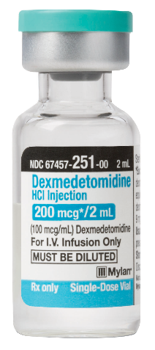
Thank you

