Slide 1
Atrial fibrillation in the Critically-ill Patients
Mazen Kherallah, MD, MHA, FCCP

Slide 2
Occurrence of Atrial Fibrillation in the ICU
Prevalent
(preexisting)
Incident
(new onset)
A patient with chronic AF develops critical illness.
A patient who was previously in sinus rhythm develops new-onset AF (NOAF) while in the ICU, secondary to the physiologic stress of critical illness (e.g., sepsis or pulmonary embolism)
1 in 3 ICU Patients

Slide 3
These situations are different from AF in other contexts:
ICU patients are often hemodynamically tenuous, so they may respond poorly to the usual AF therapies (e.g., diltiazem).
DC cardioversion alone has a low success rate among critically ill patients (70-80% of patients will usually revert back into AF).
The optimal heart rate for critically ill patients is unknown, but some patients may benefit from a mild compensatory tachycardia. Immediately pushing the heart rate down to a “normal” range (e.g., <100) can be dangerous

Slide 4
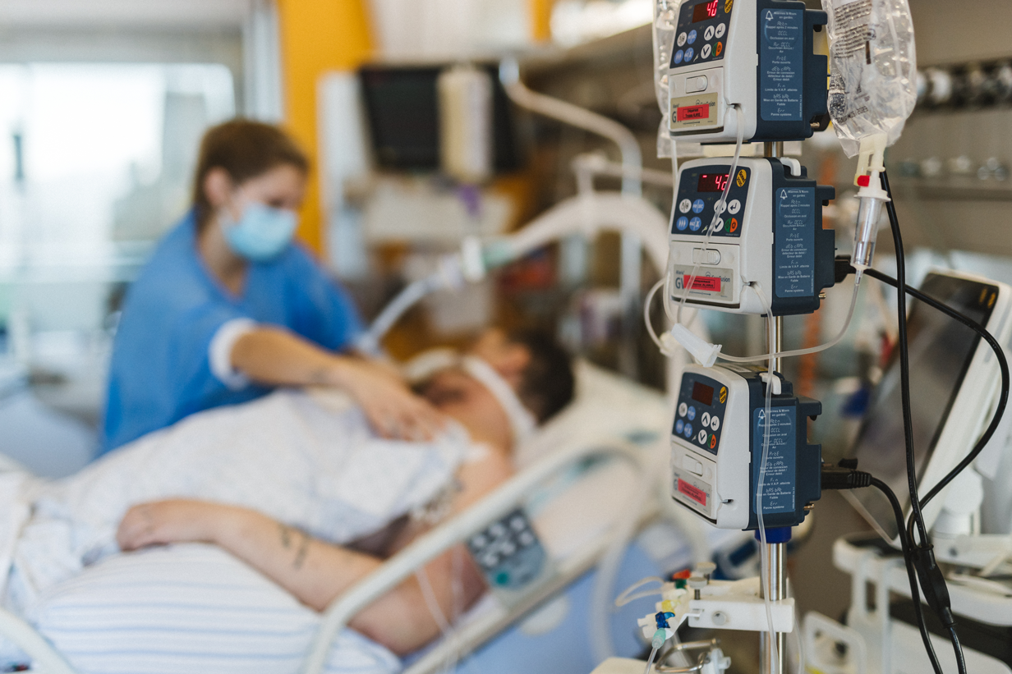
Critical Illness
Age
DM
CKD
CHF
Valvular disease
Structural Remodeling
Inflammation-Renin-angiotensin- ROS-fibrosis-stretch
Electrical Remodeling
Altered ion channels expression, activity, or ion handling
Tachycardia
Surgery
Bacterial infection
Volume overload
Arrhythmogenic Atrial Substrate
Tachycardia
Agitation/cocaine
Bacterial toxins
Thyroid storm
Antiarrhythmics
Trigger
Adrenergic stimulation
Sepsis/hypovolemia
Vasopressors
Beta-agonists
Ventilator desynchrony
Agitation
Surgery
CNS disorders
Myocyte injury
Uremic toxins
Myocardial ischemia
Right heart catheterization
Altered ion handling
Electrolyte abnormalities (hypokalemia, hypomagnesemia)
Atrial Fibrillation

Slide 5
Diagnostic Criteria for AF on EKG
No regularity.
At very high rates, the heart rate may appear to be regular “pseudo-regularization”
Fibrillation waves and no P waves.
Best seen in the inferior and right-sided precordial leads.
May be small and difficult to distinguish from artifact.
Consider obtaining a Lewis Lead EKG.
Exception: if AF is combined with heart block, then the ventricular response may be regular.
Compare to P wave morphology in prior EKGs

Slide 6
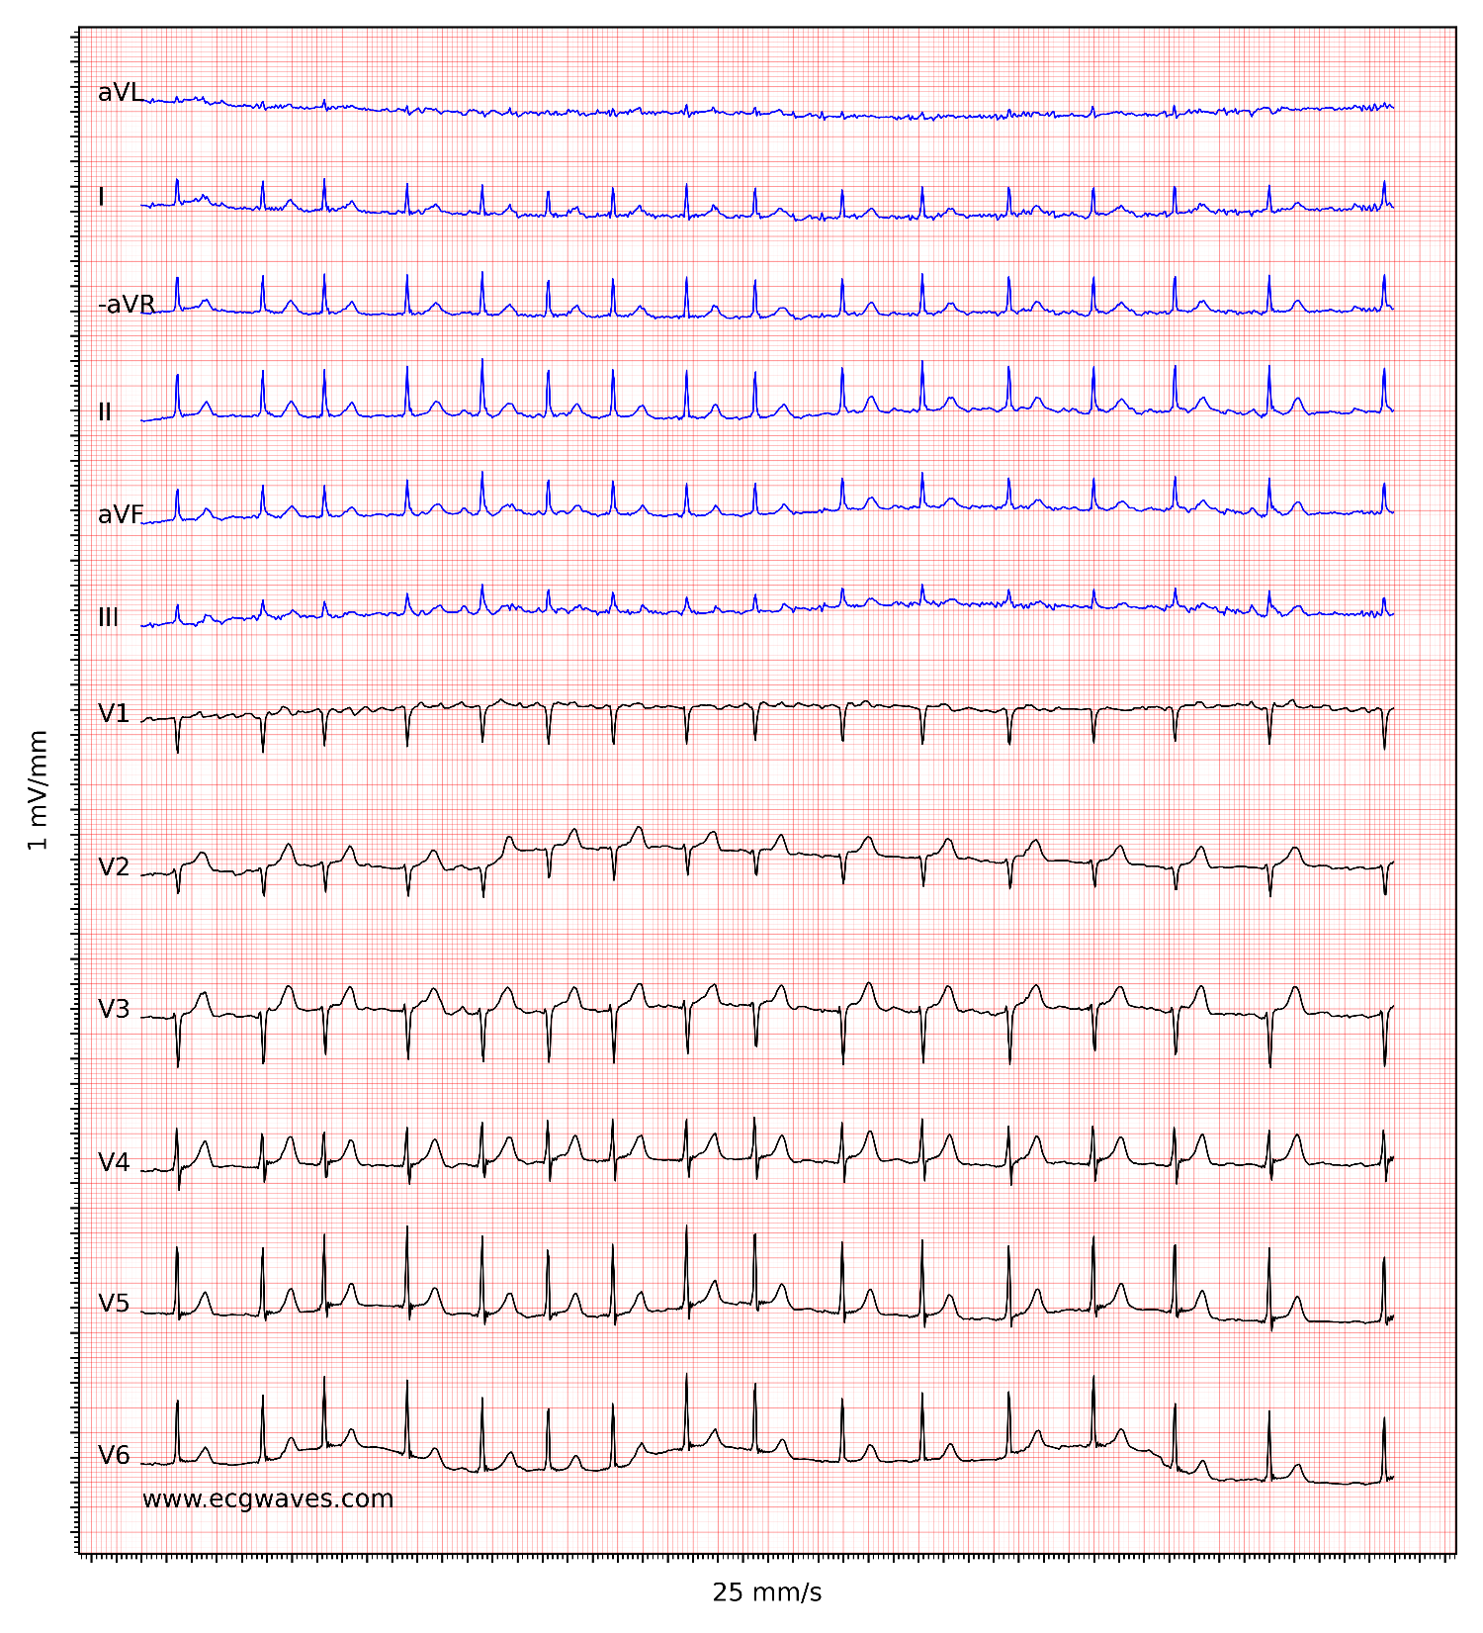

Slide 8
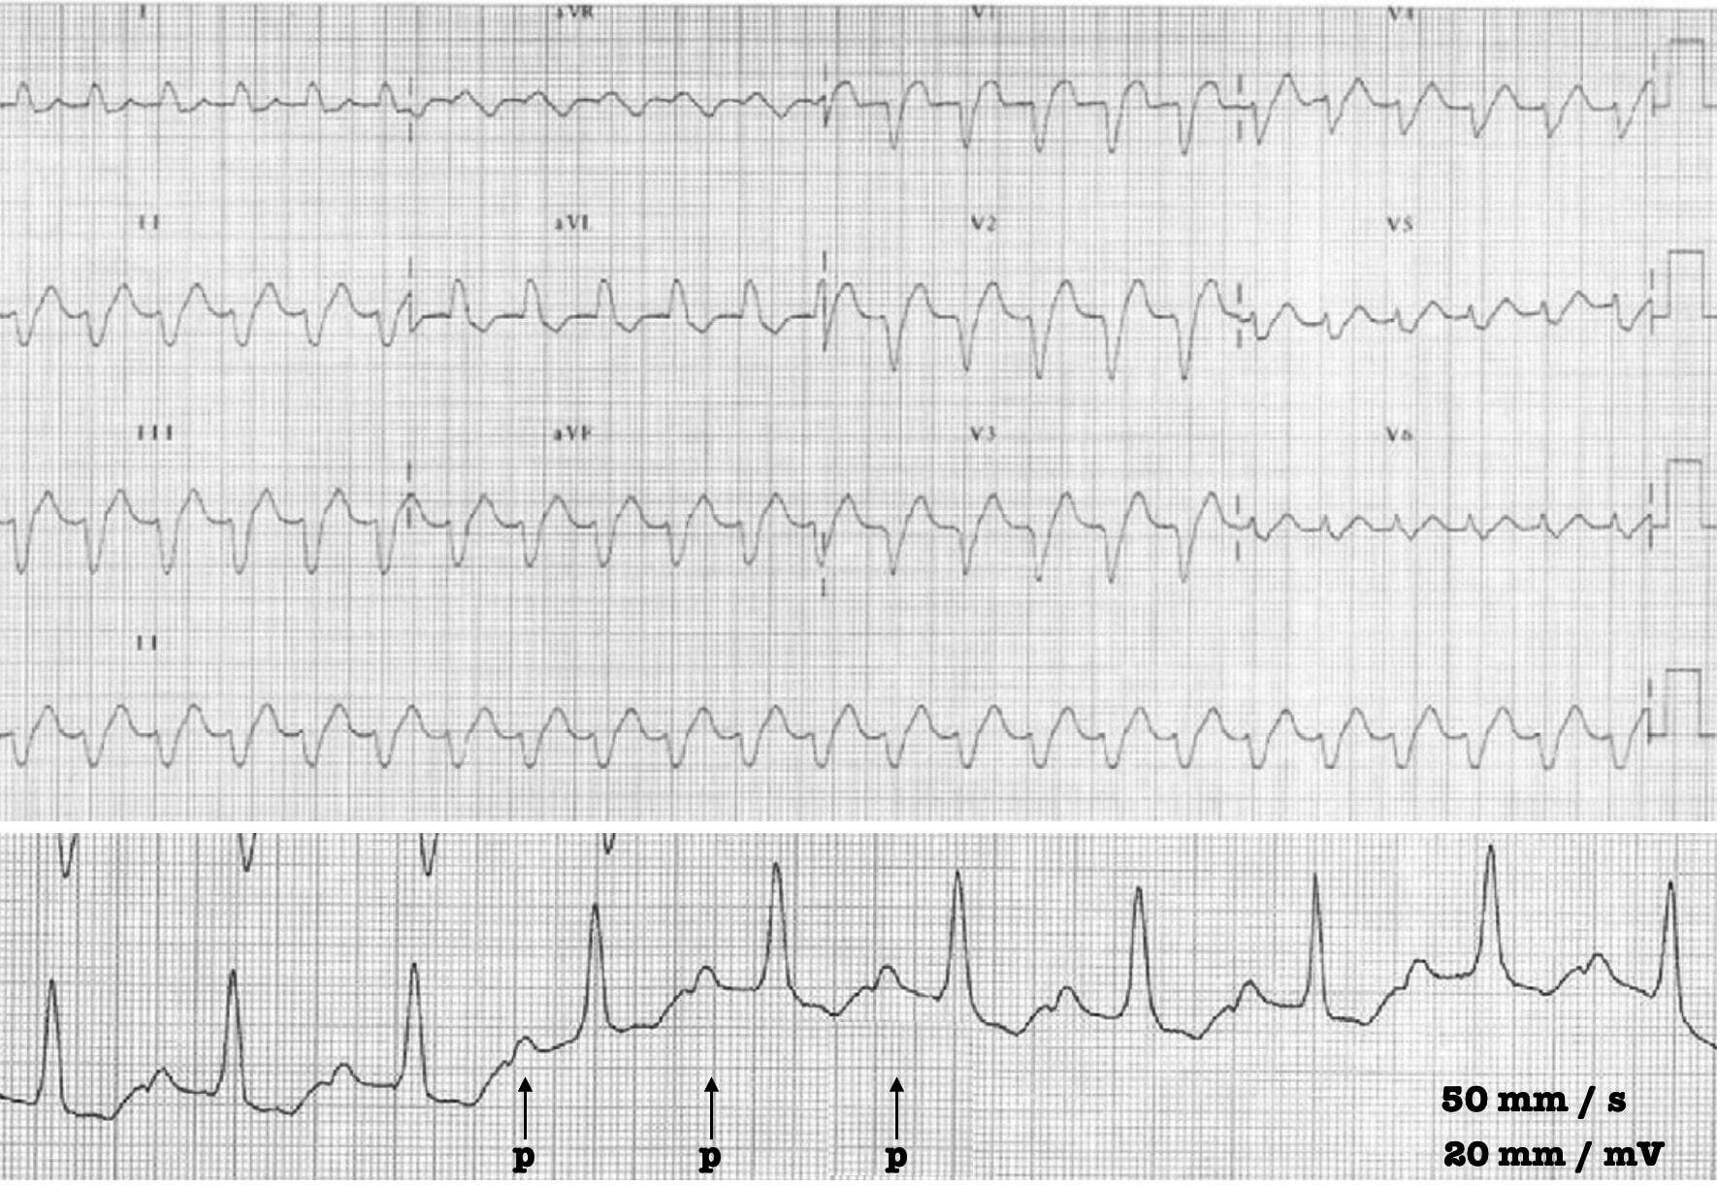
12-lead ECG: showing a wide QRS tachycardia.
Lead I strip: Lewis lead obtained with a paper speed of 50 mm/s and twice normal calibration at 20mm/mV. Regular P waves can now be clearly identified.

Slide 9
Heart Rate in AF
For most patients who aren't on medications that suppress the AV node, AF will have a heart rate of ~120-180.
If the heart rate is >>200, consider the possibility of an accessory tract (AF plus Wolff Parkinson White): shouldn't be treated with medications that impair the AV node (eg. beta-blockers, calcium channel blockers, or amiodarone) but use procainamide or ibutilide
If the heart rate is <100, conduction disease is likely

Slide 10
Management
Supportive care, stabilization, and treatment of underlying factors
Rate versus rhythm control.
Anticoagulation management

Slide 11
Hemodynamic Compromise
Direct current cardioversion
Offending agent present?
Discontinue beta agonists and antiarrhythmics if possible
Change dopamine or epinephrine
Reversible inciting factors
Correct electrolytes
Optimize volume status
Treat myocardial ischemia
Treat pain/agitation and correct ventilator dis-synchrony
Treat underlying infection/hypoxemia/thyroid storm
Persistent AF with adverse effects
Due to heart rate
RATE CONTROL
Due to loss of atrial kick
RHYTHM CONTROL
Anticoagulation?

Slide 12
Case Study
75 years-old male with PMH of COPD and diastolic dysfunction who was admitted to the ICU after a perforated diverticulitis procedure. He remained intubated and mechanically ventilation.
Patient did not have a previous history of atrial fibrillation and he is not on anticoagulation.
He developed new onset atrial fibrillation with rapid ventricular response of 160-180. His systolic blood pressure dropped from 100-120 to the 70’s mm and persisted despite fluid bolus.
Blood pressures ranged from 83/45 to 125/83, lower than usual.

Slide 13
What is the best intervention?
Amiodarone 150 mg then infusion
Echocardiography
Electrical cardioversion and amiodarone
Beta blockers
Direct-current cardioversion

Slide 14
Hemodynamic Compromise
Direct current cardioversion
Offending agent present?
Discontinue beta agonists and antiarrhythmics if possible
Change dopamine or epinephrine
Reversible inciting factors
Correct electrolytes
Optimize volume status
Treat myocardial ischemia
Treat pain/agitation and correct ventilator dis-synchrony
Treat underlying infection/hypoxemia/thyroid storm
Persistent AF with adverse effects
Due to heart rate
RATE CONTROL
Due to loss of atrial kick
RHYTHM CONTROL
Anticoagulation?

Slide 15
How Much is AF Actually Contributing to the Patient’s Instability?
 | AF is a bystander | AF is causing instability
Heart Rate | <150 | >>150
History | Chronic AF | Acute onset AF
Contest | Instability preceded AF | Deterioration after AF
Underlying structural abnormalities | Normal heart | Pulmonary HTN Mitral stenosis Diastolic dysfunction Severe aortic stenosis
Underlying electrical abnormalities | None | WPW
For most critically ill patients, the AF isn't the primary driver of instability

Slide 16
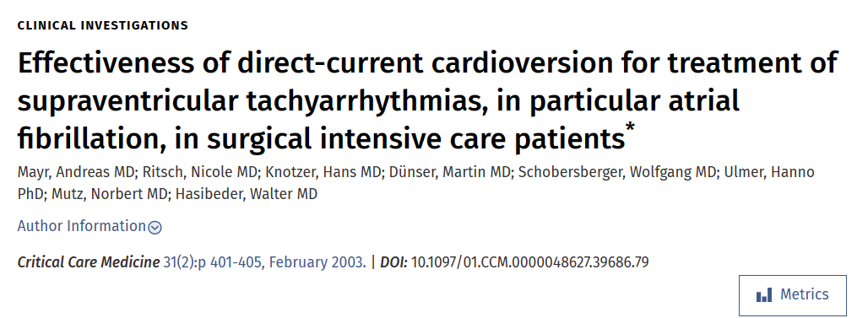
Mayr A, et al. Crit Care Med. 2003 Feb;31(2):401-5.

Slide 17
Effectiveness of direct-current cardioversion for treatment of supraventricular tachyarrhythmias, in particular atrial fibrillation, in surgical intensive care patients.
Mayr A, et al. Crit Care Med. 2003 Feb;31(2):401-5.

Slide 18
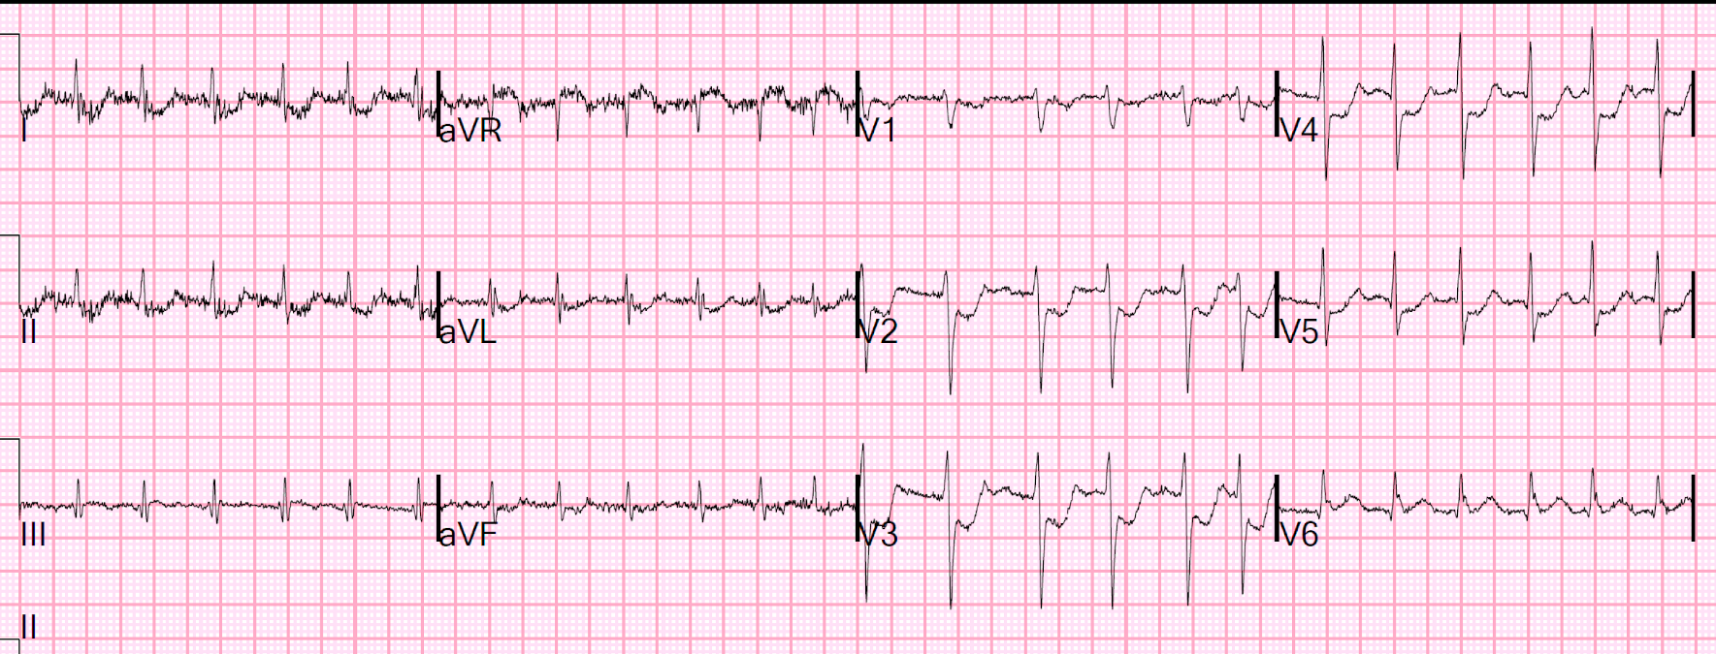
Case Study
62-year-old male with PMH of HTN and DM.
Admitted with sepsis and septic shock secondary to pneumonia
Intubated and on mechanical ventilation requiring norepinephrine at 0.5 mcg/kg/min
Developed irregular rhythm with tachycardia and SBP in the 90’s

Slide 19
What is the best intervention?
Amiodarone 150 mg then infusion
Echocardiography
Electrical cardioversion
Beta blockers
Add vasopressin and decrease norepinephrine

Slide 20
Hemodynamic Compromise
Direct current cardioversion
Offending agent present?
Discontinue beta agonists and antiarrhythmics if possible
Change dopamine or epinephrine
Reversible inciting factors
Correct electrolytes
Optimize volume status
Treat myocardial ischemia
Treat pain/agitation and correct ventilator dis-synchrony
Treat underlying infection/hypoxemia/thyroid storm
Persistent AF with adverse effects
Due to heart rate
RATE CONTROL
Due to loss of atrial kick
RHYTHM CONTROL
Anticoagulation?

Slide 21
Case Study
An elderly man with a history of diabetes and HTN presented with lethargy and weakness, decreased urine output, and hypotension.
He had no CP or SOB, and it was unknown if there was a previous history of atrial fib. He was on atenolol, but it was not known if this was simply for hypertension, or for atrial fib. He was not anti coagulated.
Blood pressures ranged from 83/45 to 125/83, lower than usual. HR ranged from 110 to 145.
Troponin is 0.13 and UA is positive for nitrite and WBC

Slide 22
Case Study

Slide 23
What is the best intervention?
Amiodarone 150 mg then infusion
Echocardiography
Electrical cardioversion
Beta blockers

Slide 25
3 liters of IVF were given

Slide 26
Hemodynamic Compromise
Direct current cardioversion
Offending agent present?
Discontinue beta agonists and antiarrhythmics if possible
Change dopamine or epinephrine
Reversible inciting factors
Correct electrolytes
Optimize volume status
Treat myocardial ischemia
Treat pain/agitation and correct ventilator dis-synchrony
Treat underlying infection/hypoxemia/thyroid storm
Persistent AF with adverse effects
Due to heart rate
RATE CONTROL
Due to loss of atrial kick
RHYTHM CONTROL
Anticoagulation?

Slide 27
Treatment of Underlying Problems
hemodynamic optimization
Discontinue beta-adrenergic vasopressors as able (especially epinephrine and dobutamine)
treatment of pain/anxiety/withdrawal
Fentanyl and adjuvant medications
Hypokalemia and hypomagnesemia
CPAP for heart failure, BiPAP for COPD, HFNC for pneumonia).
Evaluation and treatment of underlying factors
Avoid anchoring excessively on AF as the cause of the patient's hemodynamic instability.
For ongoing instability, evaluate broadly and treat appropriately. For example, uncontrolled AF could be a manifestation of sepsis, PE, thyrotoxicosis, or any cause of shock.
Add vasoconstrictors that don't stimulate beta receptors (phenylephrine or vasopressin)
Optimize volume status (fluid or diuresis)
Treatment of electrolyte abnormalities
Dexmedetomidine may be considered as an anxiolytic that will reduce sympathetic tone and decrease heart rate.
Respiratory support

Slide 28
Hemodynamic Compromise
Direct current cardioversion
Offending agent present?
Discontinue beta agonists and antiarrhythmics if possible
Change dopamine or epinephrine
Reversible inciting factors
Correct electrolytes
Optimize volume status
Treat myocardial ischemia
Treat pain/agitation and correct ventilator dis-synchrony
Treat underlying infection/hypoxemia/thyroid storm
Persistent AF with adverse effects
Due to heart rate
RATE CONTROL
Due to loss of atrial kick
RHYTHM CONTROL
Anticoagulation?

Slide 29
Rate vs. Rhythm Control
FAVERS RATE CONTROL
FAVORS RHYTHM CONTROL
Chronic atrial fibrillation
A-fib started >48 hours ago and the patient is not anticoagulated
New onset AF in the contest of critical illness
AF seems to impair hemodynamics
Atrial flutter
Failure of rate control strategy

Slide 30
Similarly low rates of persistent atrial fibrillation 60 days after onset:
Sinus rhythm in 84.2% and 86.9% (P=0.41).
Gillinov AM, et al. N Engl J Med. 2016 May 19;374(20):1911-21.

Slide 31
Agents
RATE CONTROL
RHYTHM CONTROL
Beta blockers (metoprolol or esmolol)
Nondihydropyridine calcium channel blocker
Digoxin
Magnesium ̴ 1-2 hours
Amiodarone within 24 hours
Ibutilide: 1-2 hours
DC

Slide 32
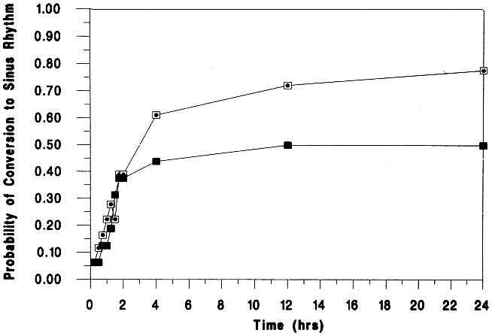
Magnesium vs Amiodarone
Intravenous magnesium sulfate is superior to amiodarone in the conversion of acute atrial tachyarrhythmias, while initial slowing of ventricular response rate in nonconverters appears equally efficacious with both agents.
Forty-two patients
Moran JL, et al. Parenteral magnesium sulfate versus amiodarone in the therapy of atrial tachyarrhythmias: a prospective, randomized study. Crit Care Med. 1995 Nov;23(11):1816-24.

Slide 33
Magnesium followed by Amiodarone
MgSO4 bolus (0.037 g/kg body weight in 15 minutes) was followed by continuous infusion (0.025 g/kg body weight/h). Intravenous amiodarone (loading dose 300 mg, followed by continuous infusion of 1200 mg/24 h) was given to those not responding to MgSO4 within 1 hour.
The 24-hour conversion rate was 90% and recurrence rate was 24%
Sleeswijk ME, et al. J Intensive Care Med. 2008 Jan-Feb;23(1):61-6.

Slide 34
Rate Control Agents
Factor | Beta blockers | Diltiazem | Amiodarone | Digoxin
Hemodynamic stability | May cause hypotension Useful in mild/moderate systolic failure | May cause hypotension Inferior to beta blockers systolic failure | Good agent for patients with borderline instability | Least likely to cause hypotension May be useful in severe systolic failure
Contraindications | Asthma exacerbation Decompensated heart failure | Decompensated heart failure | Thyroid disease Active liver disease | Renal failure (relative) Hypokalemia/hypomagnesemia Planned cardioversion s/p cardiac transplantation
Likelihood of cardioversion | ↓ | ↔ | ↑↑ | ↑
Other factors to consider | Prior favorable response to beta-blockers | Prior favorable response to diltiazem
Chronic indication to continue on this agent | Chronic systolic heart failure Hypertension | Hypertension |  | Severe systolic heart failure with AF and frequent admissionas

Slide 35
Hemodynamic Compromise
Direct current cardioversion
Offending agent present?
Discontinue beta agonists and antiarrhythmics if possible
Change dopamine or epinephrine
Reversible inciting factors
Correct electrolytes
Optimize volume status
Treat myocardial ischemia
Treat pain/agitation and correct ventilator dis-synchrony
Treat underlying infection/hypoxemia/thyroid storm
Persistent AF with adverse effects
Due to heart rate
RATE CONTROL
Due to loss of atrial kick
RHYTHM CONTROL
Anticoagulation?

Slide 36
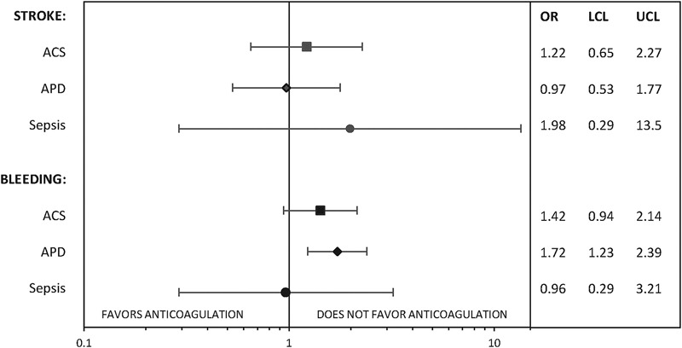
Anticoagulation in New Onset Atrial Fibrillation in the ICU
Our study demonstrates that the benefit of anticoagulation in secondary AF is not strong and can be associated with a higher risk of bleeding. Careful individual assessment regarding decisions on anticoagulation is warranted in these patients.
A retrospective study cohort was identified of 2,304 patients age 65 years or older, hospitalized with a primary diagnosis of ACS, acute pulmonary disease or sepsis, and a complication of new-onset AF during admission from 1999 to 2015
Quon MJ, Behlouli H, Pilote L. JACC Clin Electrophysiol. 2018 Mar;4(3):386-393

Slide 37
Our Practice
For most patients with new-onset AF due to critical illness, the risks of anticoagulation seem to generally outweigh potential benefits.
However, this remains largely unknown.
For some patients at high stroke risk and low bleeding risk, anticoagulation might be beneficial.

Slide 38
Hemodynamic Compromise
Direct current cardioversion
Offending agent present?
Discontinue beta agonists and antiarrhythmics if possible
Change dopamine or epinephrine
Reversible inciting factors
Correct electrolytes
Optimize volume status
Treat myocardial ischemia
Treat pain/agitation and correct ventilator dis-synchrony
Treat underlying infection/hypoxemia/thyroid storm
Persistent AF with adverse effects
Due to heart rate
RATE CONTROL
Due to loss of atrial kick
RHYTHM CONTROL
Anticoagulation?

Slide 39
Thank You

