Slide 1
Delirium Prevention
Notes:
No intervention or group of interventions reliably prevents delirium; however, multicomponent, nonpharmacologic interventions that manage many of the modifiable risk factors appear to reduce the incidence of delirium.

Slide 2
Modifying Risk Factors
Orientation protocols
Cognitive stimulation
Early mobilization
Facilitation of physiologic sleep
Visual and hearing aids
Medication choice
Pain management
Avoiding and treating medical complications
Notes:
A number of factors have been identified as causing or contributing to delirium in at-risk patients. Examples of interventions designed to mitigate risk factors for delirium include Orientation protocols, cognitive stimulation, facilitation of physiologic sleep, early mobilization, visual and hearing aids, selecting appropriate medication choice, pain management, and avoiding and treating medical complications.

Slide 3
Orientation Protocols
Clock
Calendar
Windows with outside views
Verbal reorientation
Notes:
Provision of clocks, calendars, windows with outside views, and verbally reorienting patients may help the patient in reorientation to date, time, and surroundings and mitigate confusion that results from disorientation in unfamiliar environments.

Slide 4
Cognitive Stimulation
Regular family visits
Decrease sensory stimulations
Quran recitation or music therapy
Familiar TV shows
Notes:
Patients with cognitive impairment, in particular, may benefit from activity such as regular visits from family and friends. At the same time, sensory overstimulation should be avoided, particularly at night. Familiar TV shows, quran recitation, or music therapy may help in cognitive stimulation.

Slide 5
Facilitation of Physiologic Sleep
Avoid administration of medications and medical procedures
Reduce nighttime noise
Darken the room at night
Use ear plugs
Notes:
Nursing and medical procedures, including the administration of medications, should be avoided during sleeping hours when possible and care should be clustered. Night-time noise should be reduced, and lights should be dimmed. One randomized trial found that the use of earplugs at night was associated with a lower incidence of confusion in intensive care unit (ICU) patients. To promote wakefulness during the day, use natural lights and open the blinds.

Slide 6
Early Mobilization
Physical therapy
Occupational therapy
Mobilization program
Minimize the use of physical restraints
Notes:
Minimizing the use of restraints along with having a mobilization program for early mobility and occupational therapy may help in reducing the incidence of delirium. One study in mechanically ventilated, critically ill patients found that early institution of physical and occupational therapy along with consequent interruption in use of sedatives was associated with a lower number of hospital days with delirium.

Slide 7
Visual & Hearing Aids
Visual Aids
Hearing Aids
Notes:
Use of eyeglasses and magnifying lenses for visual impairment and hearing aids and earwax disimpaction for hearing disturbances.

Slide 8
Medication Review
Avoid medications that contribute to delirium: Benzodiazepines, opioids (meperidine in particular)
Use the least amount od sedatives and analgesics for the shortest time
Involve pharmacist
Notes:
Delirium is a common condition caused by drugs in clinical settings. Most of the evidence on which drugs cause delirium comes from reports of adverse effects, rather than systematic research. Drugs with anticholinergic properties, such as tricyclic antidepressants and traditional high-dose neuroleptics, are a high-risk group for delirium. Other drugs, such as benzodiazepines, sedatives, dopamine-activating drugs, antiepileptics, histamine H2 receptor blockers, digitalis and analgesics, are also associated with delirium, but less frequently. To prevent delirium, involve the pharmacist in reviewing the medication list and avoid medications that contribute to delirium such as benzodiazepines and opioids (meperidine in particular), and use the least amount od sedatives and analgesics for the shortest time.

Slide 9
Optimize Medical Care
Tubes & lines
Hydration & nutrition
Oxygenation and infection monitoring and treatment
Pain management
Bowel and bladder care
Notes:
Medical care should be optimized to prevent delirium. Drains, Foley catheters, peripheral venous and central venous catheters should be discontinued as soon as possible. Ensure adequate hydration of the patient and adequate oral or tube feeding intake. Monitor and ensure adequate oxygenation and encourage lung expansion with deep breathing and coughing. Ensure adequate pain control and use nonopioids like acetaminophen and nonpharmacological methods. Prevent and manage constipation with adequate fiber and fluid intake and assess for urinary retention and use intermittent catheterization when needed. Infection prevention measures should be implemented, and infections should be actively monitored for and treated when identified

Slide 10
Medications to Prevent Delirium
Cholinesterase inhibitors (eg, rivastigmine, donepezil)
Melatonin
Gabapentin
Antipsychotic agents
Dexmedetomidine
Notes:
Various medications have been studied for delirium prevention in high-risk settings, but evidence of their effectiveness is limited. Cholinesterase inhibitors, such as rivastigmine and donepezil, have not effectively reduced delirium and are linked to increased side effects. Antipsychotic agents offer inconsistent and modest benefits. Dexmedetomidine shows mixed results, with some studies indicating reduced postoperative delirium. Gabapentin, in a pilot study, appeared to reduce delirium by decreasing pain and opioid use. The efficacy of melatonin and its agonists is inconsistent across studies. Finally, while analgesics like ketamine might reduce delirium incidence in some cases, their use is not consistently beneficial and is sometimes associated with adverse effects. Overall, there is no conclusive evidence supporting the broad use of these medications for preventing delirium in high-risk settings.

Slide 11
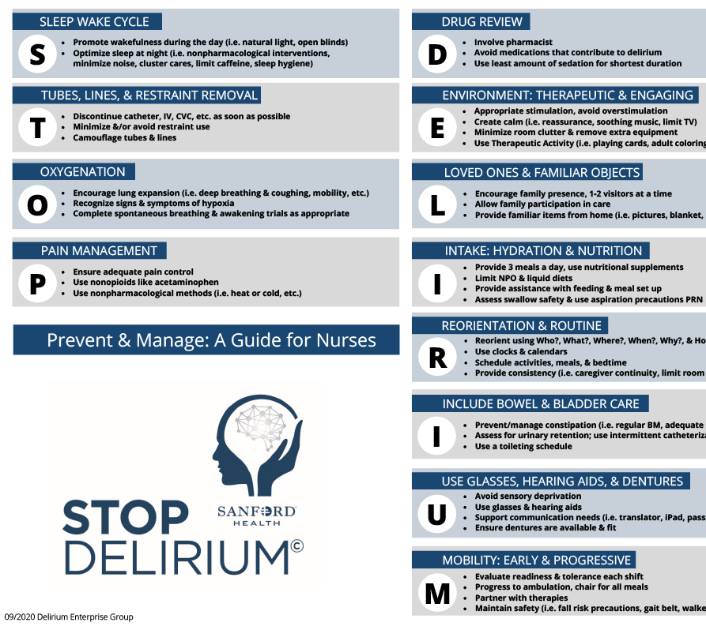
STOP DELIRIUM

