Slide 1
Prognostication of Critical Illness

Slide 2
Decision Making Process
How well the patient and/or family comprehend the prognosis?
Formulate the Prognosis
Neurological condition
Informing the Patient and/or family
Patient vs family
Making the Decision
Role of the physician in making the decision
∆ SOFA during firs 48 hours
Initial SOFA score
Known comorbidity associated with survival < 12 months
Age!
Disclosing the formulated prognosis to patient or family
Interpretation of the communicated prognosis accurately
Clinical judgment
Establishing realistic goals of care
Taking into consideration the patient’s values, goals, and preferences
Autonomy and distributive justice
What is the likelihood to achieve a particular outcome during a specific time?
What is the level of care that is most appropriate based on prognosis, patient’s values, and medicolegal aspects?

Slide 3
Shared Decision-making
Available scientific evidence
Patient’s values, goals, and preferences
Medicolegal Aspects

Slide 4
القيم الأساسية في القضايا الأخلاقية الطبية
الاستقلال الذاتي Autonomy
للمريض الحق في اختيار أو رفض طريقة معالجته
عدم الإيذاء Nonmaleficence
قدم أفضل اهتمام بالمريض واحرص على إسعاده، أي قدم الأفضل للمريض بصدق وأمانة
بقصد أو بغير قصد، قد تكون جسمية أو نفسية أو عاطفية، بإدخال عنصر مؤذ أو منع عنصر مفيد
العدالة Justice
الإنصاف في توزيع الموارد وتقرير من الذي يستحق أخذ علاج ما
الإحسان Beneficence

Slide 5
Prognostication Components

Slide 6
SOFA

Slide 7
Mortality based on Initial SOFA Score
Ferreira FL, Bota DP, Bross A, Mélot C, Vincent J. Serial Evaluation of the SOFA Score to Predict Outcome in Critically Ill Patients. JAMA. 2001;286(14):1754–1758

Slide 8
Mortality based on Highest SOFA Score
Ferreira FL, Bota DP, Bross A, Mélot C, Vincent J. Serial Evaluation of the SOFA Score to Predict Outcome in Critically Ill Patients. JAMA. 2001;286(14):1754–1758

Slide 9
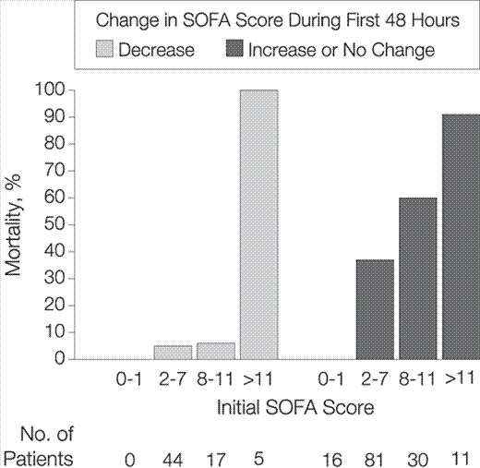
Mortality Associated with Change of SOFA Score during the First 48 Hours
Ferreira FL, Bota DP, Bross A, Mélot C, Vincent J. Serial Evaluation of the SOFA Score to Predict Outcome in Critically Ill Patients. JAMA. 2001;286(14):1754–1758

Slide 10
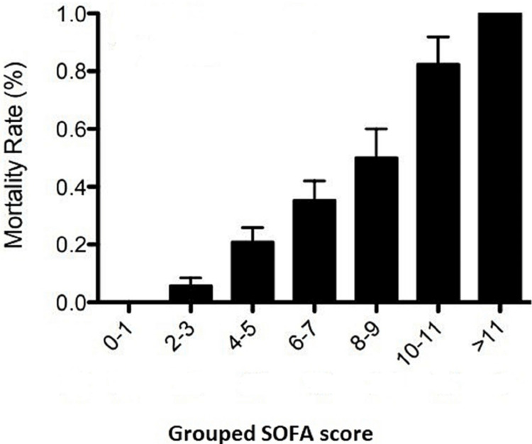

Slide 11
Proposed Strategy for Ventilator Allocation of Scarce Mechanical Ventilators
Examples of severe comorbid conditions with associated life expectancy < 1 year are listed:.
1. NYHA class IV heart failure.
2. Advanced lung disease with FEV1 < 25% predicted, total lung capacity < 60% predicted, or baseline PAO2 < 55 mm Hg.
3. Primary pulmonary hypertension with NYHA class III or IV heart failure.
4. Chronic liver disease with Child-Pugh score > 7.
5. Severe trauma.
6. Advanced untreatable neuromuscular disease.
7. Metastatic malignant disease or high-grade primary brain tumors.
Contemporary Reviews in Critical Care Medicine 1 5 5#4 CHEST A P R I L 2 0 1 9

Slide 12
Decision Making Process
How well the patient and/or family comprehend the prognosis?
Formulate the Prognosis
Neurological condition
Informing the Patient and/or family
Patient vs family
Making the Decision
Role of the physician in making the decision
∆ SOFA during firs 48 hours
Initial SOFA score
Known comorbidity associated with survival < 12 months
Age!
Disclosing the formulated prognosis to patient or family
Interpretation of the communicated prognosis accurately
Clinical judgment
Establishing realistic goals of care
Taking into consideration the patient’s values, goals, and preferences
Autonomy and distributive justice
What is the likelihood to achieve a particular outcome during a specific time?
What is the level of care that is most appropriate based on prognosis, patient’s values, and medicolegal aspects?

