Slide 1
Evidence-based Management of Steroid Use in Septic Shock
Mazen Kherallah, MD, FCCP

Slide 2
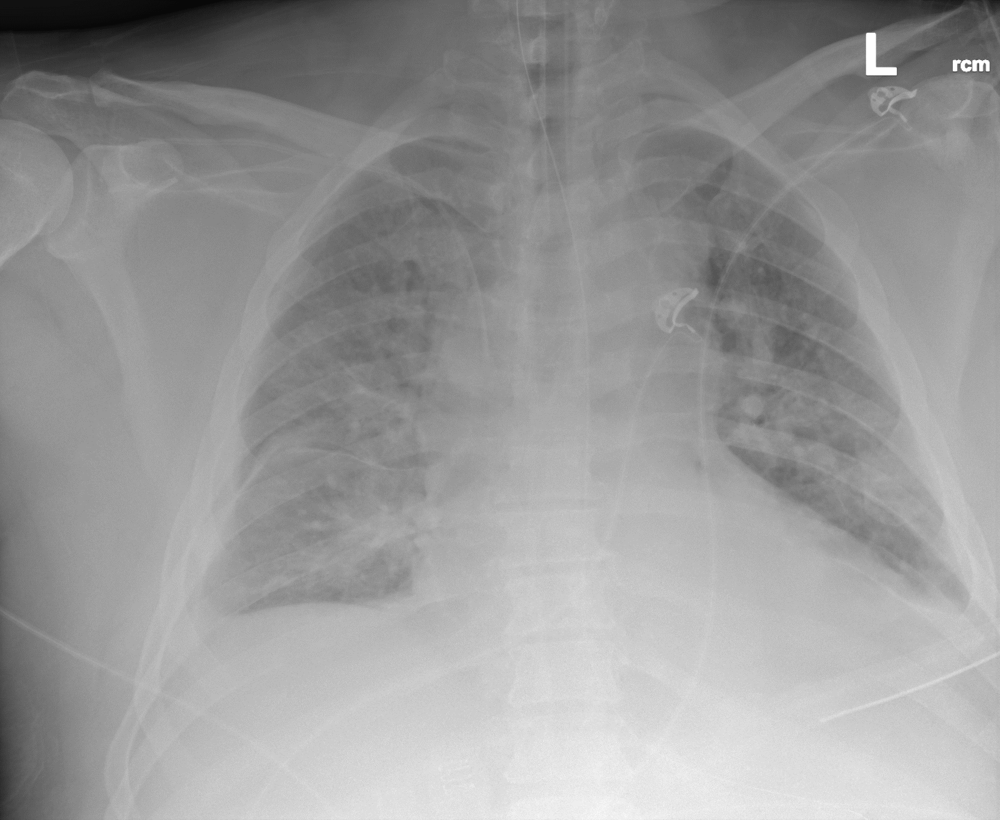
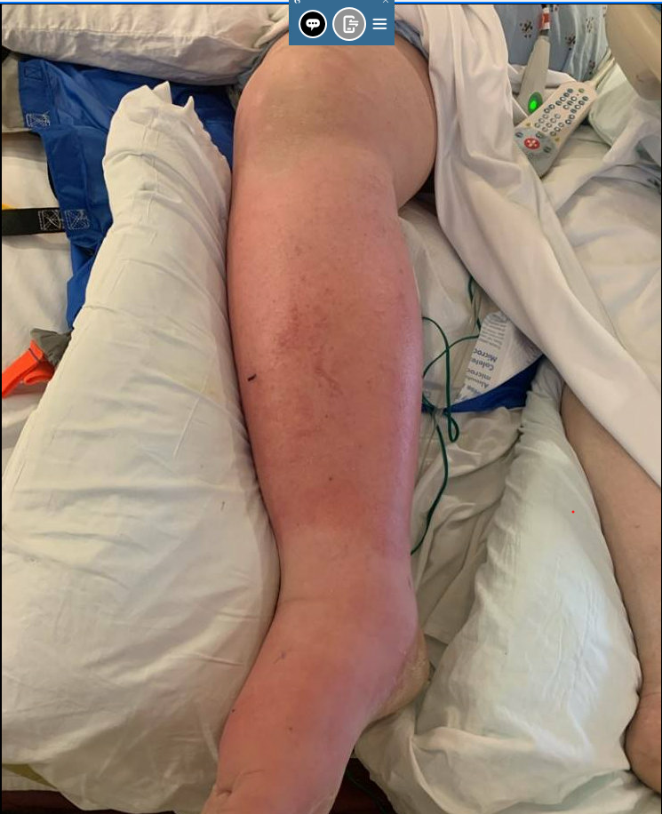
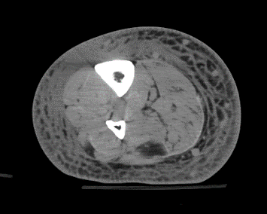
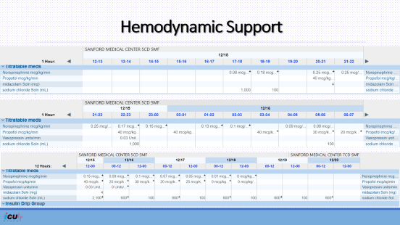
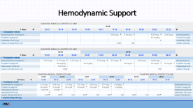
Case Presentation
58 year old male with medical history significant for CML on tyrosine kinase inhibitor, diabetes mellitus, hypertension, peripheral neuropathy, venous thromboembolism admitted 12/15/2023 with right lower extremity swelling, pain and redness, associated with fever and chills. He has a history of right lower extremity cellulitis.
Assessment
Hemodynamics BP 89/52 HR 140/min LA 3.7 | Respiratory RR 24 breaths/min 7.20/58/84/94% 4-5 L/min |  |  | ID WBC 19.3 Procalcitonin 80.7 |  | Renal Low urine output Creatinine 4.46 BUN 45
Fluid bolus 3.5 L then 150 mL/hour Norepinephrine | BiPAP |  |  | Pip/taz |  | IV boluses
Vasopressin | Intubated on APVcmv |  |  | Meropenem/vancomycin/clindamycin |  | Fluid maintenance

Slide 4
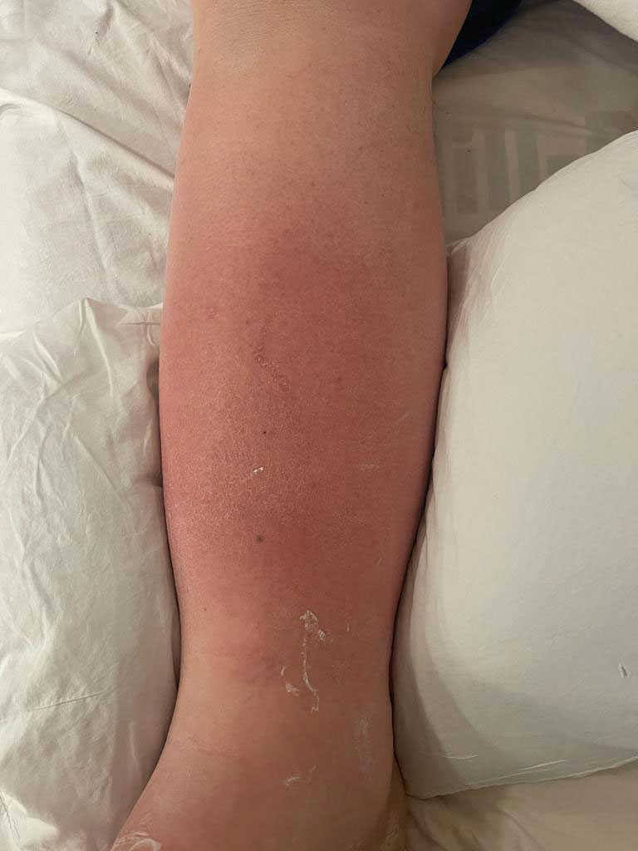

Slide 5
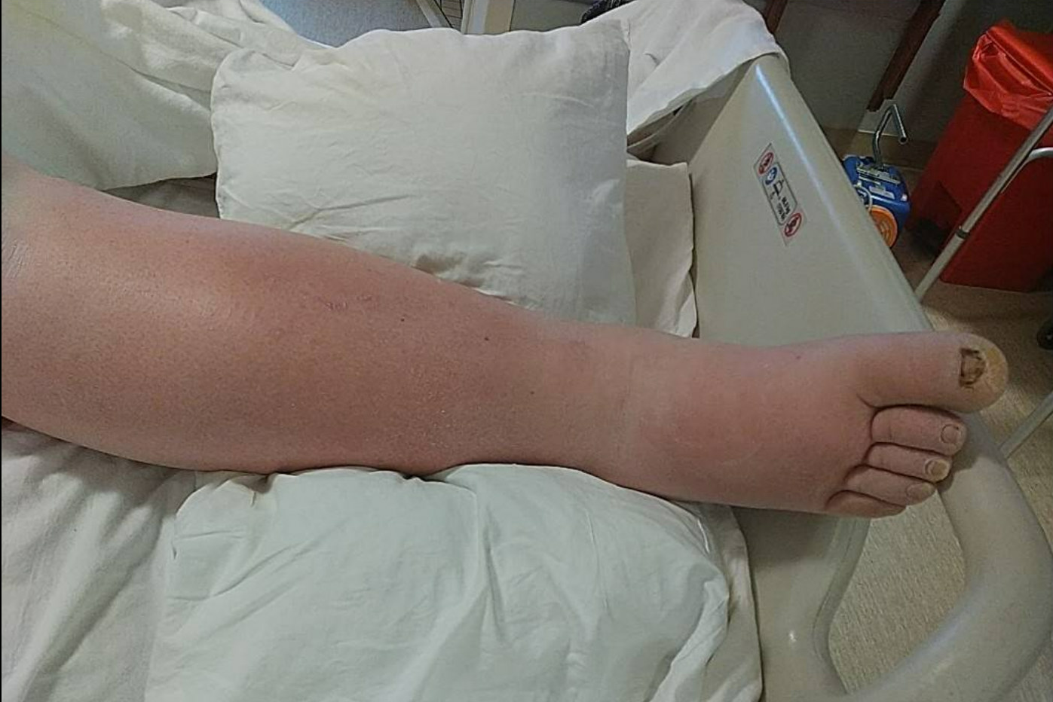
Notes:
Previous cellulitis

Slide 6
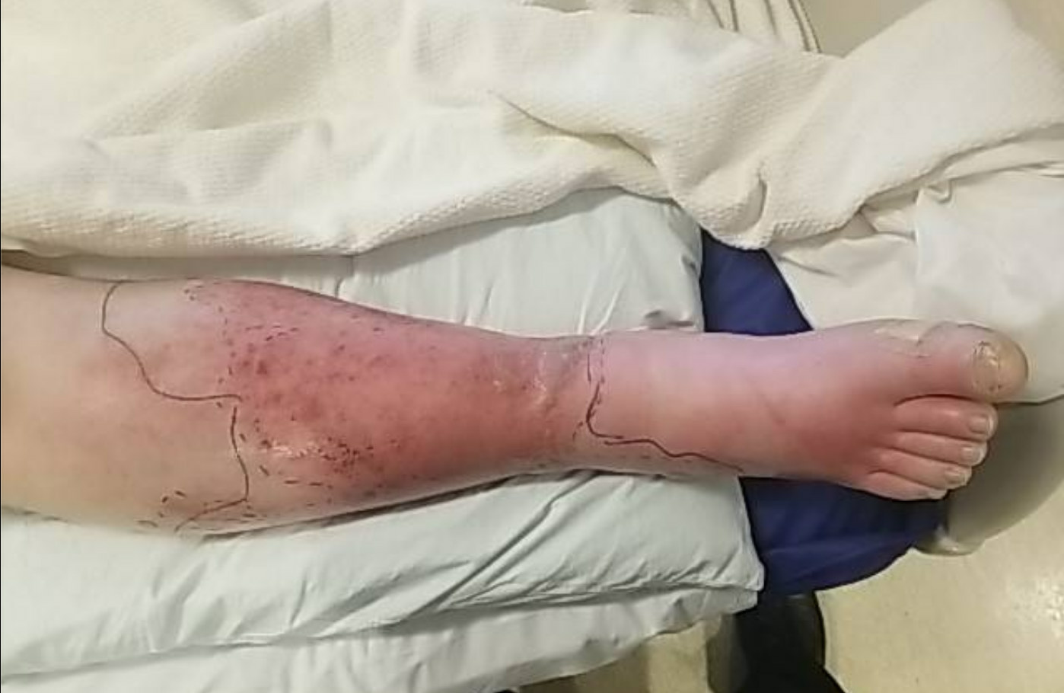
Notes:
Previous cellulitis

Slide 7
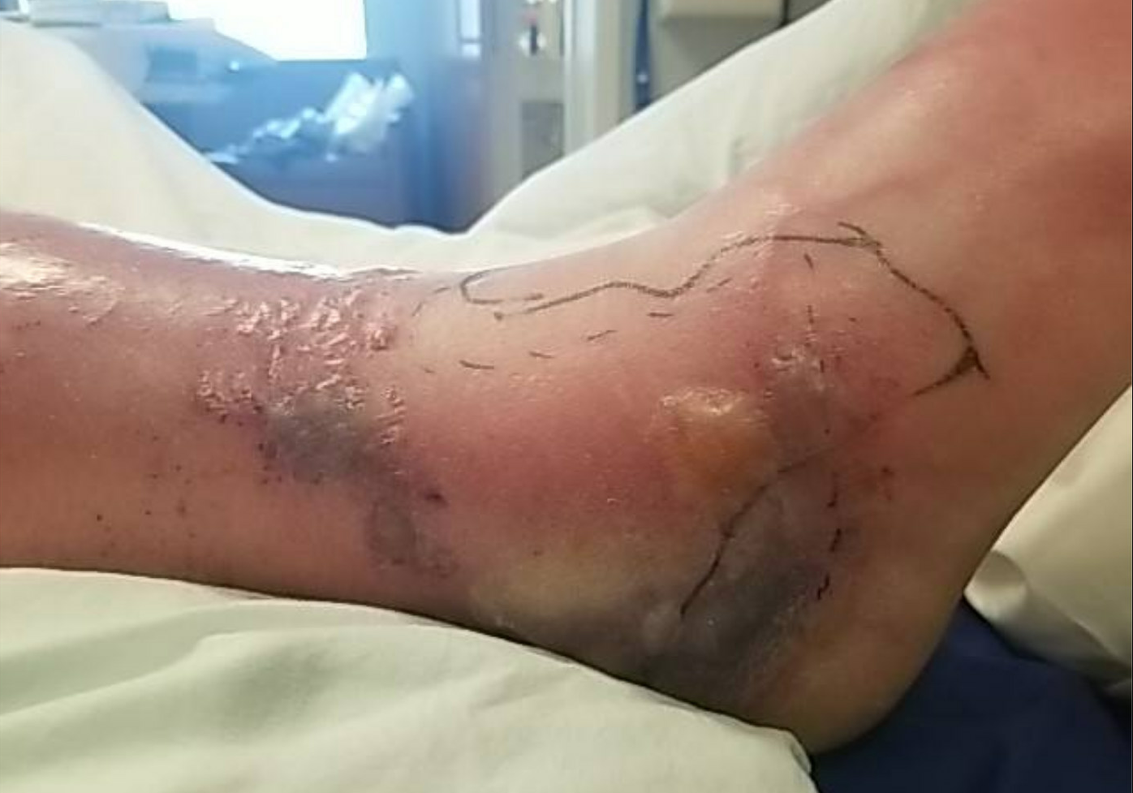
Notes:
Previous cellulitis

Slide 9

Notes:
CT scan of the right lower extremity shows extensive subcutaneous fat stranding throughout the visualized portion of the lower extremity concerning for severe edema or cellulitis with no evidence of abscess or soft tissue gas

Slide 10
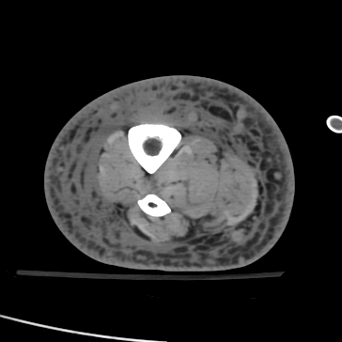
Notes:
1. Extensive subcutaneous fat stranding throughout the visualized portion of the lower extremity concerning for severe edema or cellulitis.
2. No evidence of abscess. No soft tissue gas.
3. Small right knee joint effusion

Slide 11
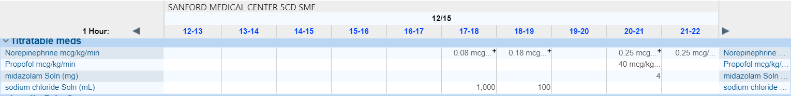
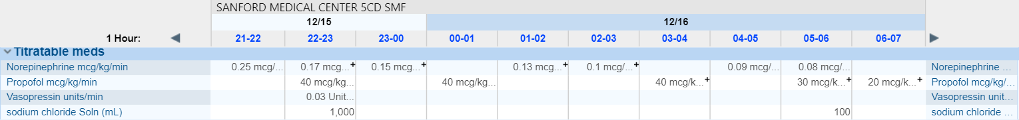
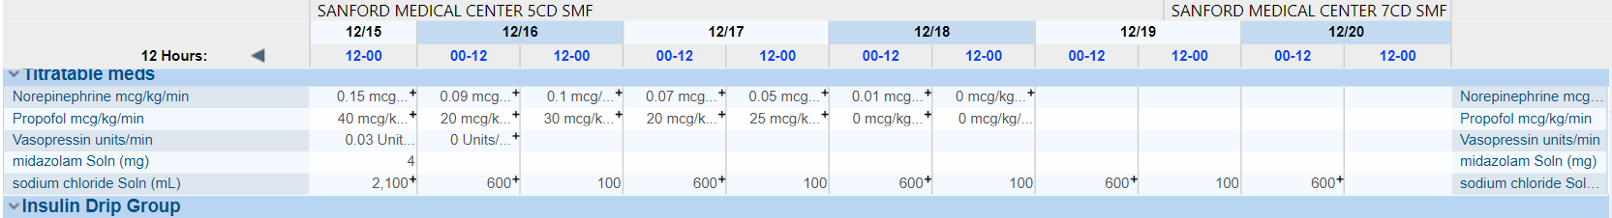
Hemodynamic Support

Slide 12
Questions?
What is the rational of using steroid in sepsis?
How long do we keep on steroids?
Should adrenal reserve be assessed?
Does the use of steroid prevent progression to shock in sepsis?
Do we need to add fludrocortisone?
What are the benefits of steroid in sepsis?
When to start steroids and how much?
Do we stop or taper?
What are the expected adverse events with steroid?

Slide 13
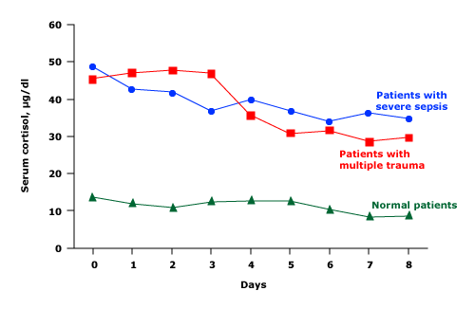
Rationales for Glucocorticoid in Septic Shock
HPA* activation (resulting in increased levels of circulating cortisol)
HPA impairment (resulting in adrenocortical hyporesponsiveness)
Glucocorticoid resistance
Diurnal variation is lost and serum cortisol increases, reaching levels as high as 40 to 50 mcg/dL^
By head injury, central nervous system depressants, pituitary infarction, adrenal hemorrhage, infections, malignancy, previous glucocorticoid therapy, and several drugs (phenytoin, and etomidate)
Higher expression levels of the beta-isoform of the glucocorticoid receptors
Modulation of an excess inflammatory response
Critical illness-related corticosteroid insufficiency
Relative adrenal insufficiency
(suboptimal cortisol production for total body demands)
No consensus about the diagnostic criteria
* HPA: hypothalamic-pituitary-adrenal axis
^Vadas P, Pruzanski W. Plasma cortisol levels in patients with septic shock. Crit Care Med. 1991 Feb;19(2):300-1.

Slide 14
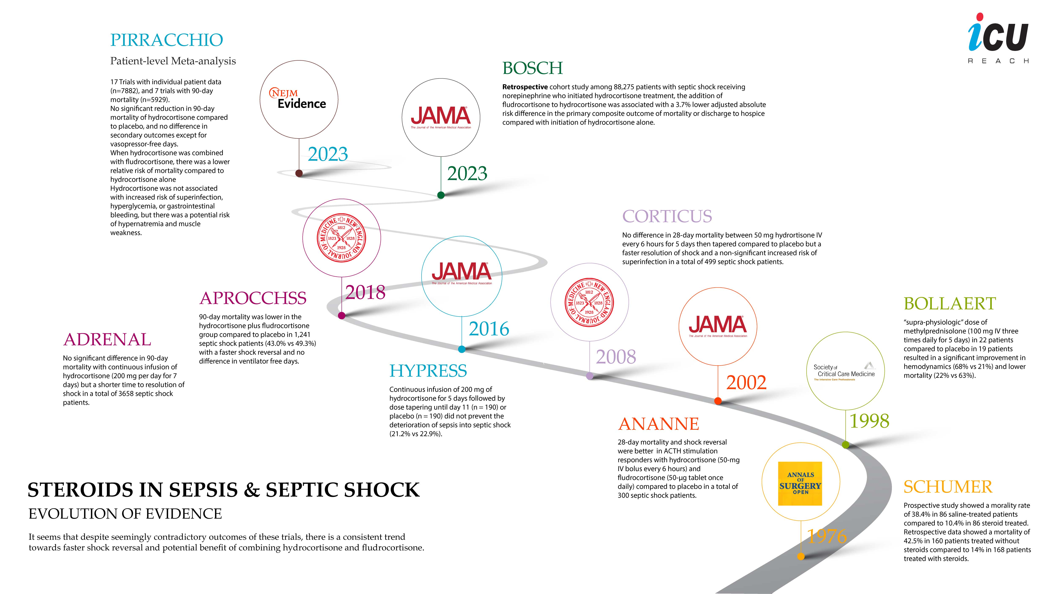


Mortality

Slide 15
Shock Reversal

Slide 16
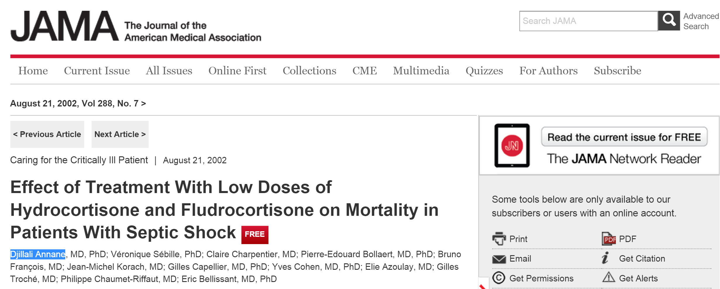

63% vs 53% Mortality

Slide 17




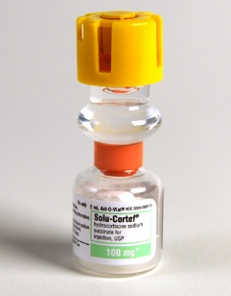


Hydrocortisone Therapy for Patients with Septic Shock
 | CORTICUS Trial
499 patients with septic shock, 52 ICUs Mar 2002 to Nov. 2005
 | Hydrocortisone | Placebo
# of Patients | 251 | 248
28 Day Mortality | 34.3% | 31.5%
X

Slide 18
Hydrocortisone Therapy for Patients with Septic Shock
28-day mortality: 34.3% vs 31.5%

Slide 19
Kaplan–Meier Curves for the Time to Reversal of Shock
P<0.001

Slide 20

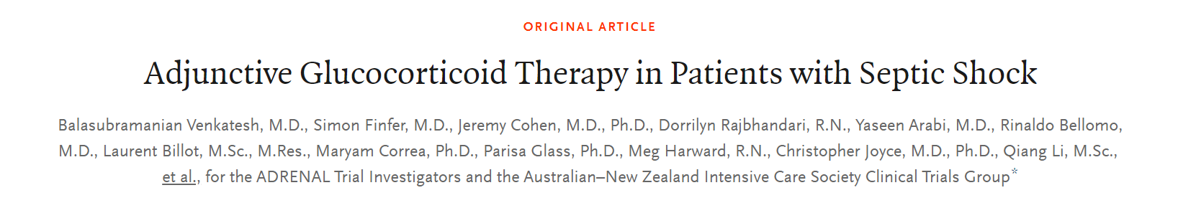

The ADRENAL Trial
Venkatesh B. et al. N Engl J Med 2018; 378:797-808

Slide 21





Adjunctive Glucocorticoid Therapy in Patients with Septic Shock
The ADRENAL Trial
3800 ICU patients on mechanical ventilation with septic shock Multicenter, randomized, and controlled: March 2013 through April 2017
 | Hydrocortisone | Placebo
# of Patients | 1832 | 1826
90 Day Mortality (%) | 27.9% | 28.8%
Resolution of Shock (median) | 3 days | 4 days
X
√
X odds ratio, 0.95; 95% confidence interval [CI], 0.82 to 1.10; P=0.50
√ hazard ratio, 1.32; 95% CI, 1.23 to 1.41; P<0.001
Venkatesh B. et al. N Engl J Med 2018; 378:797-808

Slide 22
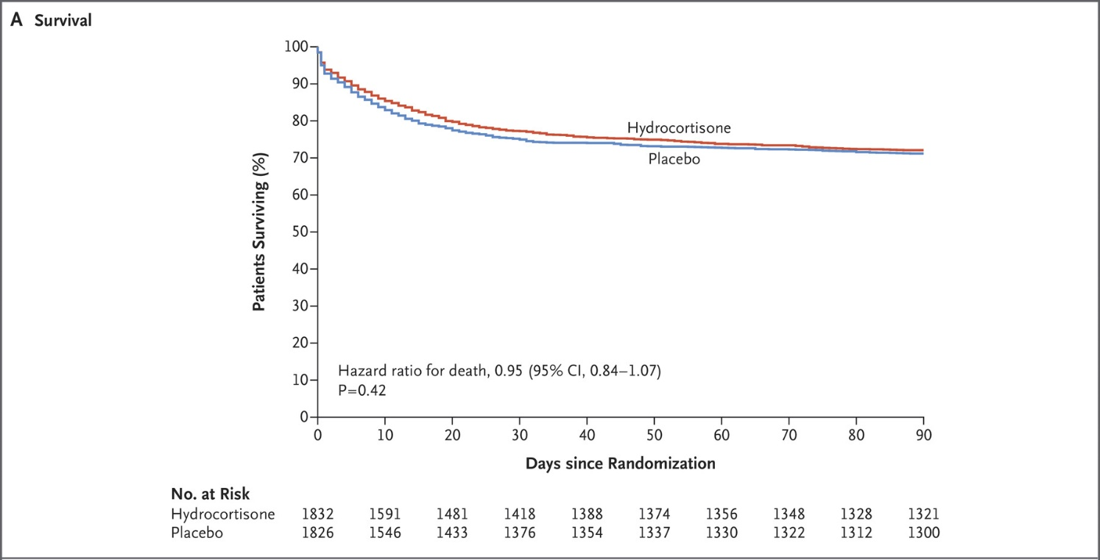
Adjunctive Glucocorticoid Therapy in Patients with Septic Shock
Venkatesh B. et al. N Engl J Med 2018; 378:797-808

Slide 23
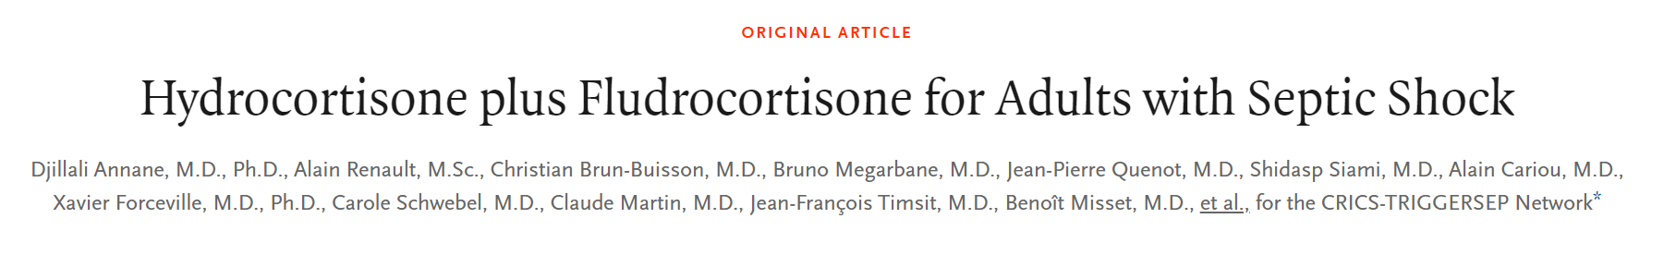
The APROCCHSS Trial
Annane D, et al. N Engl J Med. 2018;378:809

Slide 24

Hydrocortisone plus Fludrocortisone for Adults with Septic Shock
The APROCCHSS Trial
1241 ICU patients with septic shock Multicenter, randomized, and controlled
 | Hydrocortisone | Placebo
# of Patients | 614 | 627
90 Day Mortality (%) | 43% | 49.1%
Vasopressor-free days | 17 days | 15 days
√ P=0.03
√ P<0.001
Annane D, et al. N Engl J Med. 2018;378:809

Slide 25

Original Article
Patient-Level Meta-Analysis of Low-Dose Hydrocortisone in Adults with Septic Shock
Romain Pirracchio, M.D., M.P.H., Ph.D., Djillali Annane, M.D., Ph.D., Andre K. Waschka, Ph.D., François Lamontagne, M.D., M.Sc., Yaseen M. Arabi, M.D., Pierre-Edouard Bollaert, M.D., Laurent Billot, M.D., Bin Du, M.D., Josef Briegel, M.D., Jeremy Cohen, M.D., Simon Finfer, M.D., Anthony Gordon, M.D., Naomi Hammond, R.N., M.P.H., Ph.D., Herve Hyvernat, M.D., Didier Keh, M.D., Yi Li, M.D., Ling Liu, M.D., Gianfranco Umberto Meduri, M.D., Liliana Mirea, M.D., John A. Myburgh, M.D., Charles L. Sprung, M.D., Ph.D., Neijla Tilouche, M.D., Surat Tongyoo, M.D., Balasubramanian Venkatesh, M.D., Ruiqiang Zheng, M.D., and Anthony Delaney, M.D., Ph.D.
NEJM Evid
Volume 2(6):EVIDoa2300034
May 23, 2023

Slide 26
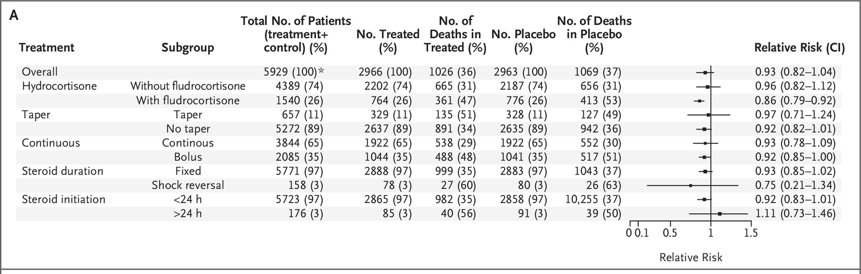
Association between Steroid and 90-Day Mortality
Pirracchio R, Annane D, Waschka AK, et al. Patient-level meta-analysis of low-dose hydrocortisone in adults with septic shock. NEJM Evid 2023;2(6).

Slide 27
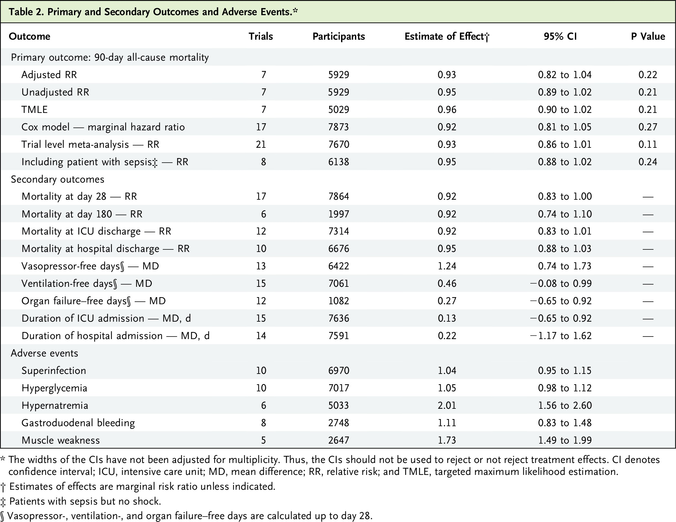
Pirracchio R et al. NEJM Evid2023;2:EVIDoa2300034
Pirracchio R, Annane D, Waschka AK, et al. Patient-level meta-analysis of low-dose hydrocortisone in adults with septic shock. NEJM Evid 2023;2(6).
Notes:
Table 2 Primary and Secondary Outcomes and Adverse Events.

Slide 28
Should Adrenal Reserve be Assessed?
ACTH Stimulation Test
Random Plasma Cortisol
Change in baseline cortisol at 60 min of <9 mcg/dL after corticotropin (250 mcg; ie, high-dose ACTH stimulation) administration*
≤10 mcg/dL (total).
Free cortisol level is more accurate but not available in most centers
Unreliable in critically ill patients
Failed to consistently identify patients with septic shock who benefit from glucocorticoid use in major RCTs
*Studies using high-dose ACTH stimulation (250 mcg cosyntropin) have yielded variable results in septic shock

Slide 29
CORTICUS Trial
28-day mortality: 39.2% vs 36.1% , P = 0.69
28-day mortality: 28.8% vs 28.7% , P = 1.00

Slide 30
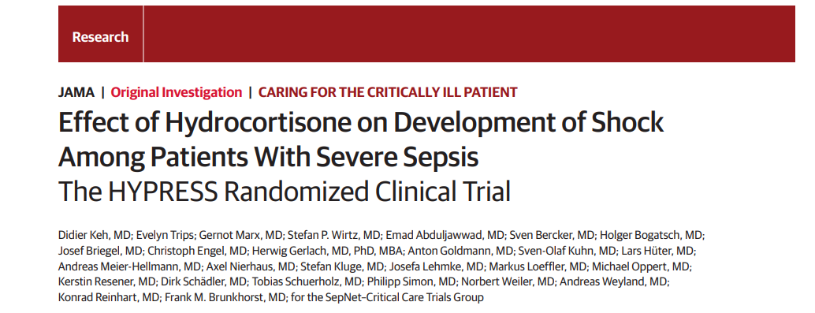
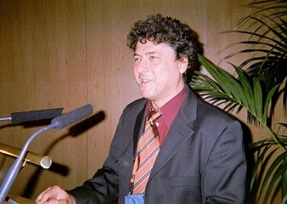


Slide 31
Effect of Hydrocortisone on Development of Shock Among Patients With Severe Sepsis
The HYPRESS Randomized Clinical Trial | The HYPRESS Randomized Clinical Trial
353 septic patients without septic shock January 13, 2009, to August 27, 2013,
 | Hydrocortisone | Placebo
# of Patients | 170 | 170
Occurrence of septic shock | 21.2% | 22.9%
difference, −1.8%; 95% CI, −10.7% to 7.2%; P = .70

Slide 32
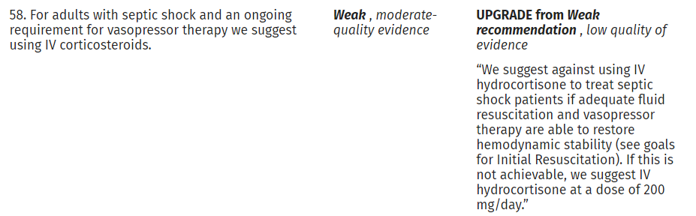
Recommendations
Evans, L. et al. Surviving Sepsis Campaign: International Guidelines for Management of Sepsis and Septic Shock 2021, Critical Care Medicine: November 2021 - Volume 49 - Issue 11

Slide 33
Steroid Use in Septic Shock
Septic shock
Volume & norepinephrine
Ongoing vasopressor need in first 1-3 hours
Hydrocortisone 50 mg IV q 6hrs
May consider fludrocortisone 100 mcg orally

Slide 34
Mortality Benefit

Slide 35
Association between Steroid and 90-Day Mortality
Pirracchio R, Annane D, Waschka AK, et al. Patient-level meta-analysis of low-dose hydrocortisone in adults with septic shock. NEJM Evid 2023;2(6).

Slide 36
Results should be interpreted with caution!
Only two trials included fludrocortisone
More severe shock than did the patients that comprised the overall meta-analysis cohort
mean norepinephrine dose of the cohort was 1.08 micgs/kg/min of norepinephrine, whereas only 26% of patients in the overall cohort of the meta-analysis had a norepinephrine equivalent dose that was greater than 0.6 micg/kg/min
Higher percentage of patients with a pulmonary source of infection compared with the overall meta-analysis cohort
59.4% vs. 32%
Fludrocortisone subgroup represents a minority of patients in the cohort, making the statistical validity of this finding difficult to assess

Slide 37
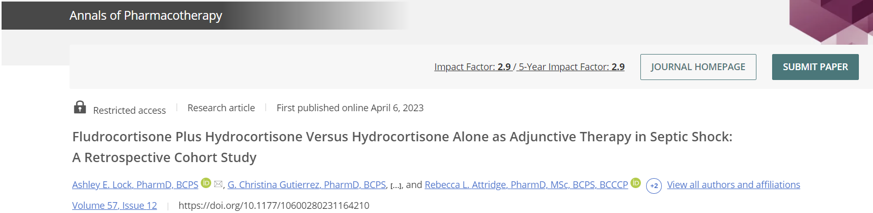
FC + HC was not associated with shock reversal at greater than 72 hours or decreased in-hospital mortality in a retrospective study that included 251 patients.

Slide 38
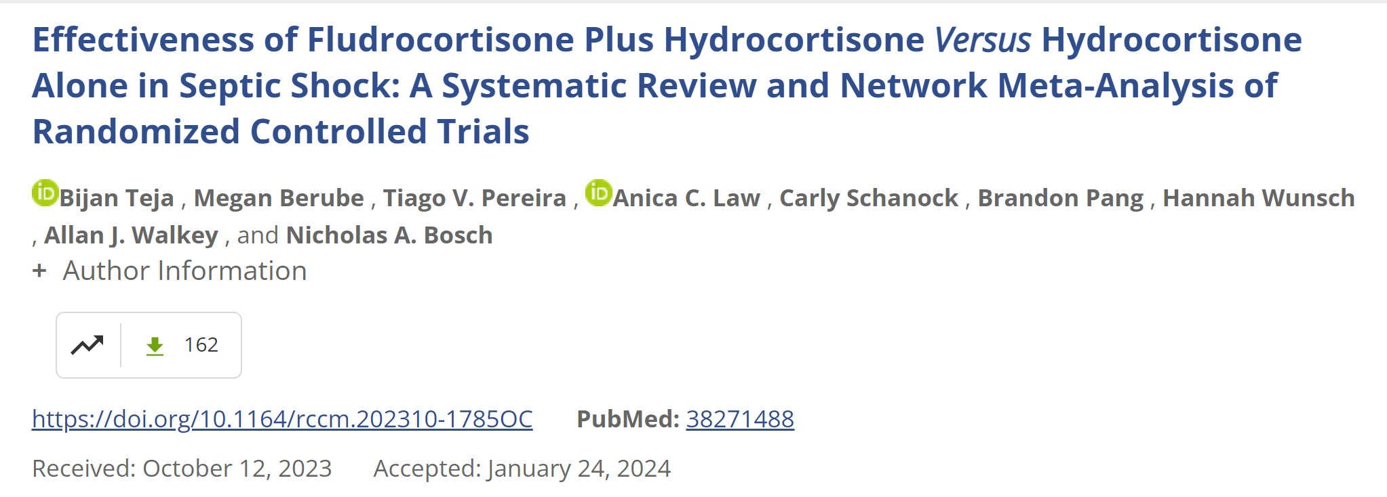
In a systematic review and Bayesian network meta-analysis of 17 trials (7,688 patients), fludrocortisone plus hydrocortisone showed a lower risk of all-cause mortality in adult septic shock compared to hydrocortisone alone and placebo/usual care. The combination treatment had a 0.85 relative risk of mortality (moderate-certainty evidence) and was 12% more effective than hydrocortisone alone (low-certainty evidence). The analysis relied mainly on indirect evidence due to limited direct comparisons.

Slide 39
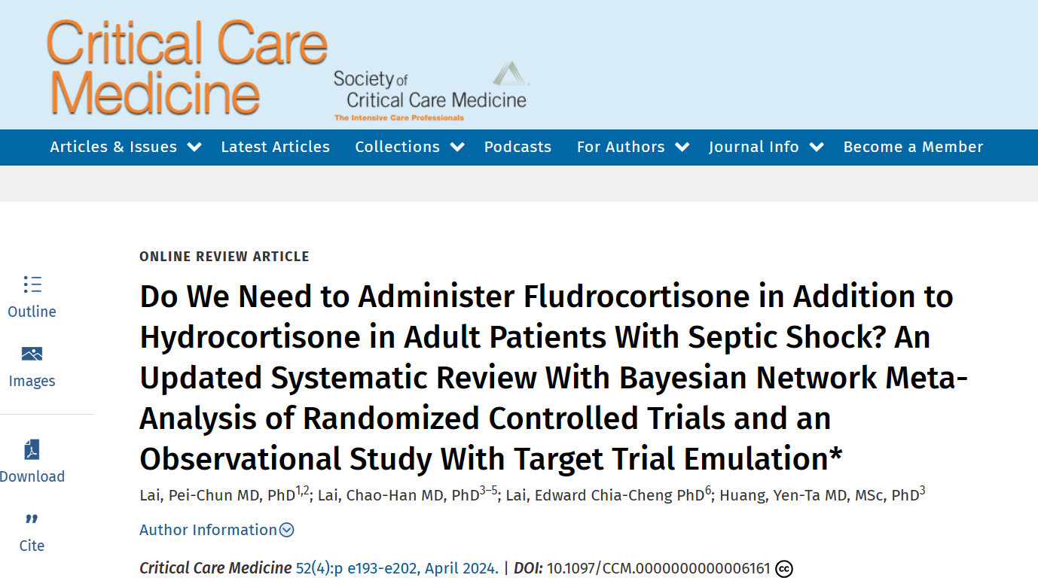
Lai, Pei-Chun MD, PhD et al.. Critical Care Medicine 52(4):p e193-e202, April 2024.

Slide 40
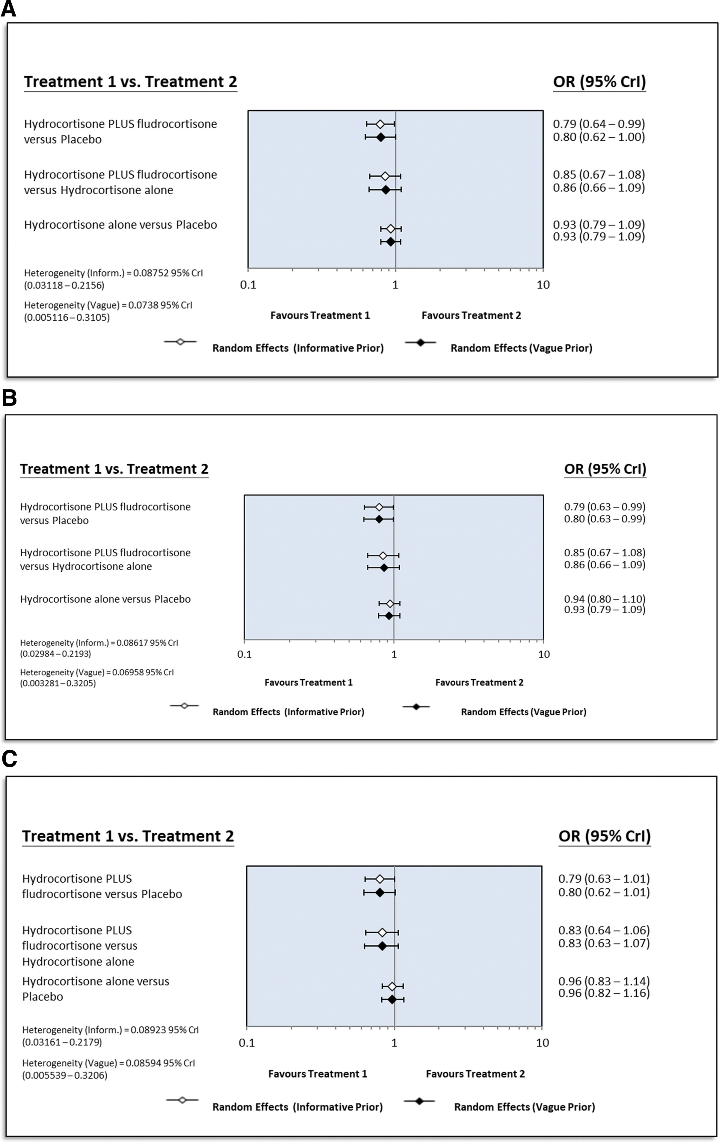
A total of 19 studies involving 95,841 patients were included. Hydrocortisone plus fludrocortisone showed the lowest short-term mortality versus placebo (odds ratio [OR]: 0.79; 95% credible interval [CrI], 0.64–0.99; number needed to treat [NNT]: 21, range: 12–500; low certainty of evidence)
Notes:
Forest plots presenting the odds ratios for short-term mortality among treatment groups receiving either combined hydrocortisone and fludrocortisone, hydrocortisone alone, or placebo: includes all studies (A); has been narrowed down to randomized controlled trials (B); and specifically examines randomized controlled trials administering an initial daily hydrocortisone dosage of 200 mg (C). CrI = credible interval, OR = odds ratio

Slide 41
Pirracchio R et al. NEJM Evid2023;2:EVIDoa2300034
Pirracchio R, Annane D, Waschka AK, et al. Patient-level meta-analysis of low-dose hydrocortisone in adults with septic shock. NEJM Evid 2023;2(6).
Notes:
Table 2 Primary and Secondary Outcomes and Adverse Events.

Slide 42
Association between Steroid and 90-Day Mortality
Pirracchio R, Annane D, Waschka AK, et al. Patient-level meta-analysis of low-dose hydrocortisone in adults with septic shock. NEJM Evid 2023;2(6).

Slide 43
Steroid Use in Septic Shock
Septic shock
Volume & norepinephrine
Ongoing vasopressor need in first 1-3 hours
Hydrocortisone 50 mg IV q 6hrs
Shock reversal or 7 days
Stop hydrocortisone
May consider fludrocortisone 100 mcg orally

Slide 44
Association between Steroid and 90-Day Mortality
Pirracchio R, Annane D, Waschka AK, et al. Patient-level meta-analysis of low-dose hydrocortisone in adults with septic shock. NEJM Evid 2023;2(6).

Slide 45
Hemodynamic Support

Slide 47
Questions?
What is the rational of using steroid in sepsis?
How long do we keep on steroids?
Should adrenal reserve be assessed?
Does the use of steroid prevent progression to shock in sepsis?
Do we need to add fludrocortisone?
What is the benefit of steroid in sepsis?
When to start steroids and how much?
Do we stop or taper?
What are the expected adverse events with steroid?
Relative adrenal insufficiency
Shock reversal
No
No
Ongoing vasopressor support
Maybe
Muscle weakness and hypernatremia
Till shock reversal
Stop

Slide 48
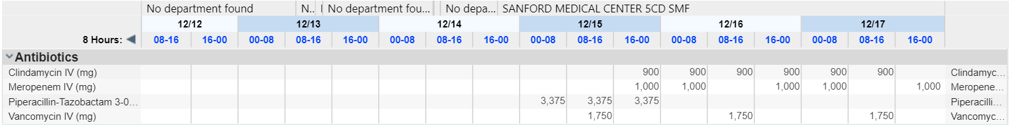

Slide 49
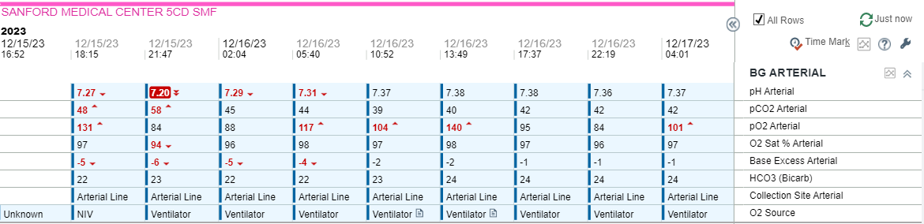

Slide 50
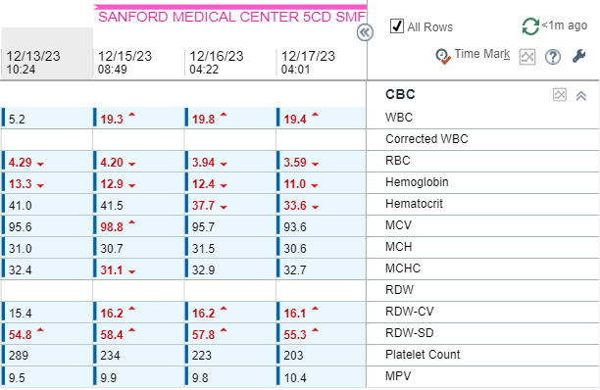

Slide 51
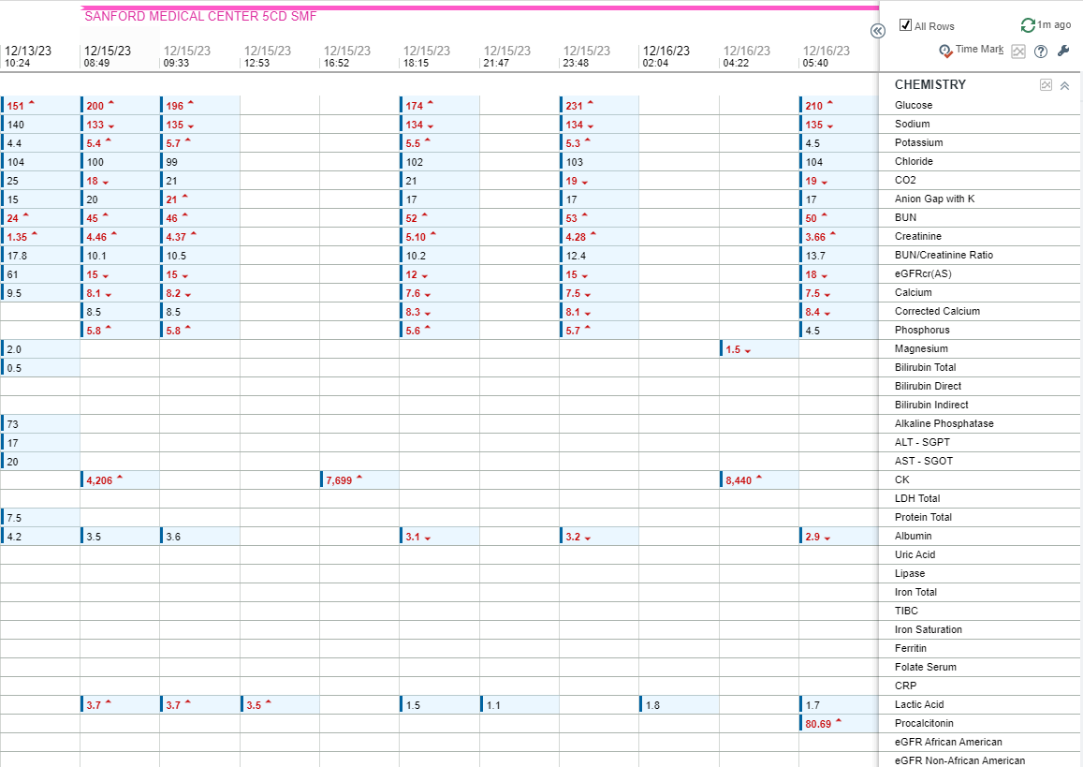

Slide 52
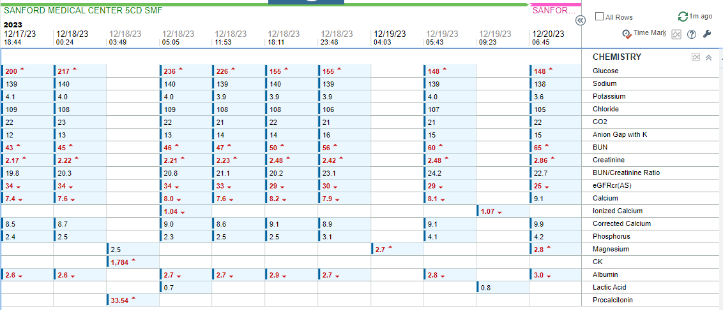

Slide 53
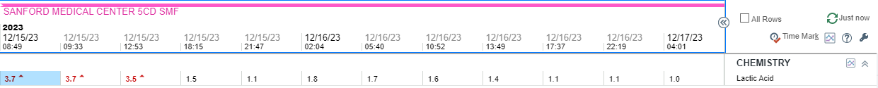
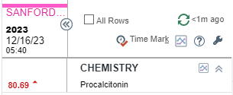

Slide 54
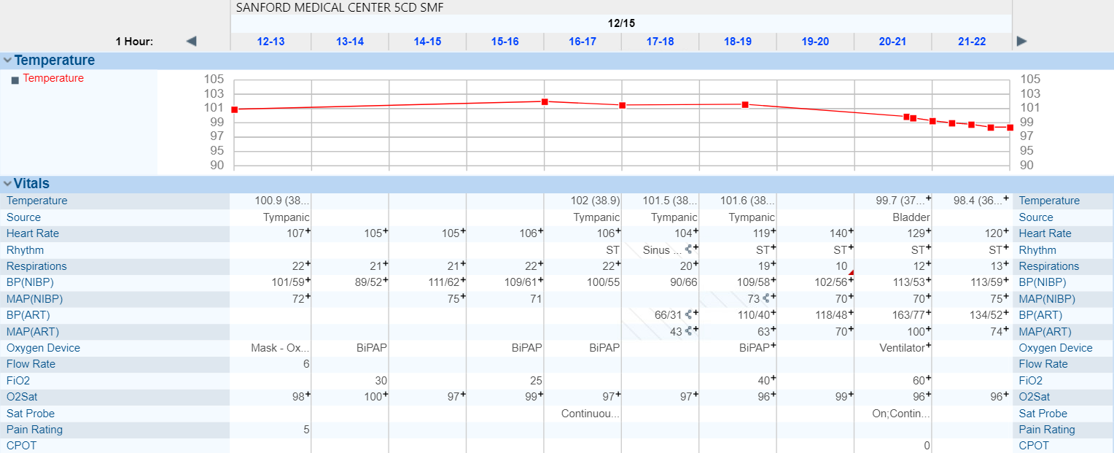

Slide 55


