Slide 1
Continuous vs Intermittent β-Lactam Antibiotic Infusions
Mazen Kherallah, MD, FCCP

Slide 2
Outline
Pharmacodynamic properties of medication
Pharmacodynamic parameters of antibiotics
Pharmacodynamic therapeutic goals of antibiotics
Rationales for continuous infusion of beta lactams
Pharmacokinetic changes of antibiotics in septic patients
Higher MIC of organisms
Evolving evidence of continuous infusion of beta lactam agents

Slide 3
Pharmacodynamic Parameters
Concentration
C_{max}
C max is the maximum measurable drug concentration at the end of an infusion BEFORE significant distribution occurs
The time required for the TOTAL amount of remaining drug in the body to decline by 50%.
½ Life
Area under the curve
AUC
C_{min}
Drug concentration before the next dose: Trough
0
Time
Notes:
The slide illustrates key pharmacodynamic parameters of antibiotics, focusing on their concentration over time within the body. Here are the main elements:
C_max (Maximum Concentration):
This is the highest concentration of the drug in the bloodstream, measured at the end of an infusion before significant distribution occurs. It represents the peak level of the drug achieved after administration.
Half-Life (½ Life):
The half-life is the time required for the total amount of the drug in the body to be reduced by 50%. It is a critical parameter in determining the dosing interval and duration of the drug's effectiveness.
AUC (Area Under the Curve):
The area under the curve represents the total exposure of the body to the drug over time. It is a measure of the drug's presence in the bloodstream throughout the dosing period.
C_min (Minimum Concentration or Trough):
This is the lowest concentration of the drug in the bloodstream, typically measured just before the next dose is administered. It is essential for ensuring that the drug remains at therapeutic levels between doses.
These parameters help in understanding the drug’s pharmacokinetics, which influences how it should be dosed to achieve optimal therapeutic effects while minimizing toxicity. The image illustrates the relationship between these parameters graphically, showing the rise and fall of drug concentration over time following a single dose.

Slide 4
Pharmacodynamic Parameters of Antibiotics
Concentration
C_{max}:MIC
Aminoglycosides Daptomycin Fluoroquinolones Ketolides
Vancomycin
Azithromycin Clindamycin Oxazolidinones Tetracyclines
AUC:MIC
Beta-lactams
Carbapenems Erythromycin Linezolid
T>MIC
MIC
PAE
Aminoglycosides
Fluroquinolones
0
Time
Notes:
The slide provides a detailed overview of the pharmacodynamic parameters of antibiotics, highlighting different metrics that guide dosing strategies based on the type of antibiotic and its activity against pathogens. Here are the key elements described:
C_max/MIC (Maximum Concentration to Minimum Inhibitory Concentration Ratio):
This parameter is important for antibiotics such as aminoglycosides, daptomycin, fluoroquinolones, and ketolides. It represents the ratio of the peak drug concentration (C_max) to the minimum inhibitory concentration (MIC) of the pathogen. High C_max/MIC ratios are desired for these antibiotics to maximize bactericidal activity.
AUC/MIC (Area Under the Curve to Minimum Inhibitory Concentration Ratio):
This ratio is crucial for antibiotics like vancomycin, azithromycin, clindamycin, oxazolidinones, and tetracyclines. It represents the total drug exposure over 24 hours (AUC) relative to the MIC. Higher AUC/MIC ratios correlate with better clinical outcomes for these antibiotics.
T>MIC (Time Above Minimum Inhibitory Concentration):
For antibiotics such as beta-lactams, carbapenems, erythromycin, and linezolid, the duration of time that the drug concentration remains above the MIC (T>MIC) is critical for efficacy. Maintaining drug levels above the MIC for a sufficient duration ensures effective bacterial killing.
MIC (Minimum Inhibitory Concentration):
The MIC is the lowest concentration of an antibiotic that inhibits visible growth of a microorganism. It is a standard measure used to assess the potency of an antibiotic against specific pathogens.
PAE (Post-Antibiotic Effect):
The PAE is the persistent suppression of bacterial growth after a brief exposure to an antibiotic. Aminoglycosides and fluoroquinolones exhibit significant PAE, allowing for less frequent dosing while maintaining efficacy.
These pharmacodynamic parameters help in tailoring antibiotic therapy to optimize therapeutic outcomes while minimizing resistance and adverse effects. The image graphically represents these concepts, showing how different antibiotics utilize these parameters to achieve their clinical effects.

Slide 5
Pharmacodynamic Therapeutic Goals of Antibiotics
Parameter correlating with efficacy | Cmax:MIC | T>MIC | AUC:MIC | PAE
Antibiotic | Aminoglycosides Colistin Daptomycin Fluoroquinolones Ketolides | Carbapenems Cephalosporins Penicillins Erythromycin | Vancomycin Fluroquinolones | Aminoglycosides Fluroquinolones
Organism killing | Concentration-dependent | Time-dependent | Concentration/time-dependent | Post-antibiotic effect
Therapeutic goal | High dose: C_{max}/MIC>10 | Higher frequency, prolonged duration C_{min}>MIC | Optimize exposure to antibiotic: C_{max}/MIC>10 and C_{min}>MIC | Lower frequency

Slide 6
Pharmacokinetic Changes of Antibiotics in Septic Patients
Healthy
Large Volume of Distribution
Increase Drug Clearance
↑Vd:
Fluid Resuscitation
↓Vd
Vd
↑Cl
↑Cardiac Output
Cl
Cl
C_{max}
↓C_{max}
↓C_{max}
Concentration
Concentration
Concentration
↓T>MIC
T>MIC
MIC
↑T>MIC
MIC
MIC
AUC
AUC
↓AUC
Time
Time
Time
↓maximum concentration (C_{max}) but a longer half-life (T_{1/2})
↓AUC, T_{1/2} and T > MIC
Gonçalves-Pereira and Póvoa Critical Care 2011 15:R206
Notes:
ICU patients present pharmacokinetic changes of antibiotics that may alter bacterial exposure. Concentration-time curve of antibiotics in healthy volunteers (left panel). A large volume of distribution (V_{d}) (middle panel) is often present in ICU patients, leading to decreased maximum concentration (C_{max}) but a longer half-life (T_{1/2}) and eventually higher time that the antibiotic concentration is above the bacteria minimum inhibitory concentration (T > MIC). The antibiotic area under the concentration time curve (AUC) remains virtually the same. An increase in drug clearance (Cl) (right) is associated with decreases in AUC, T_{1/2} and T > MIC. Straight dotted lines-bacteria minimum inhibitory concentration.

Slide 7
Higher MIC Organisms
C_{max}
Concentration
Extended Infusion
T>MIC
MIC
AUC
Time
Notes:
The MIC is the lowest concentration of the antibiotic that inhibits the visible growth of the organism. For higher MIC organisms, this value is higher, indicating a need for higher or more sustained drug concentrations to achieve therapeutic effectiveness.

Slide 8
Continuous vs Intermittent Infusion of β-Lactams in Critically Ill Septic Patients
β-Lactam administration via prolonged (with an infusion time of 4 hours) or continuous infusion will lead to sustained concentrations throughout the dosing interval, longer time above MIC, and improved bacterial eradication. But does a better pharmacokinetic target mean a better clinical outcome?

Slide 12
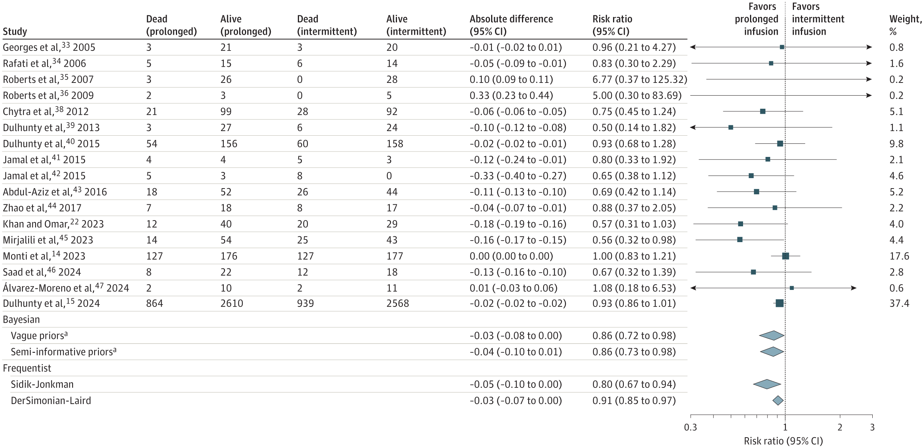

Slide 13
Continuous vs Intermittent Infusion of β-Lactams in Critically Ill Septic Patients
Prolonged infusions of β-lactam antibiotics were associated with a lower risk of 90-day mortality and ICU mortality (high certainty), and higher clinical cure rates (moderate certainty) compared to intermittent infusions among adults in the intensive care unit who had sepsis or septic shock

